Slide 1


A Paddler’s Guide to Safety
U.S. Coast Guard Auxiliary, in cooperation with the
American Canoe Association
2023
Notes:
This course aims to help you safely enjoy paddling. You should be able to:
Understand and select the right equipment for how and where you paddle;
Prepare thoroughly for your paddling experiences
Know about and locate a variety of resources for paddling safety, including online and in-person training.
INSTRUCTOR: This course was developed in cooperation with the American Canoe Association. It may be taught by any currently certified ACA instructor or by any currently certified Auxiliary instructor comfortable presenting the content. The Paddlecraft Safety Division encourages Auxiliary instructors not comfortable with the content to attend a familiarization briefing offered by the Division or to review previously recorded Train the Trainer briefings. Auxiliary instructors also can consult ACA instructors or AUXPAD Operators and Qualifiers to learn more about paddling safety.
ACA instructors can pull any resource they want to use for instruction. This presentation will be available for download, so anyone could use it. By explicitly allowing ACA instructors to use it, we’re recognizing the MOU between ACA and the Auxiliary and spreading the presentation’s exposure. We’ll be explicitly allowing people to do what they could already do, allowing the Auxiliary to gain some benefit.
Note: the photos and graphics included in this presentation are copyright and fee-free. Whenever a product is shown, it is for illustrative purposes only and does not imply any Coast Guard, Coast Guard Auxiliary, or American Canoe Association endorsement.

Slide 2
Let’s Start with a Few Questions
What do you paddle?
Where do you paddle?
How well do you paddle?
What do you hope to learn?
Notes:
INSTRUCTOR NOTE: This slide is intended to assist the instructor in profiling the audience and engaging them in the instructional experience from the outset. You can use the information you gather in tailoring your content and teaching style to the group.
By a show of hands, what’s your paddle craft? (Kayak, whitewater kayak, fishing kayak, SUP, canoe?) Then probe each individual: sit on top or cockpit, tandem, etc., as appropriate.
Where do you paddle (as needed, probe: calm water, river, open water, etc.
By a show of hands, how would you rate your experience level (new, novice, intermediate, advanced)?
Why did you sign up for this class? What do you hope to learn? (Be sure everyone answers.)
Thanks! Let’s go on.

Slide 3
Here’s What We’ll Cover
I. Knowledge and Gear
II. Stages of a Trip
III. SUP and Fishing
IV. Resources
V. Open Forum
Notes:
There are five sections to this course. Each has specific learning objectives.
After section one, you should be able to understand and select the right equipment and safety gear for the paddling that you do.
After section two, you should be able to plan your paddling experiences from start to finish safely.
Those of you who are SUP paddlers/kayak anglers should learn the special safety considerations for your sport and apply them.
After section four, you should be able to locate a variety of resources that should enable you to learn more about safety, obtain safety-related information, online file safety (float) plans, and more.
After section five, you should have questions not covered by this presentation answered as best we can.

Slide 4
I. KNOWLEDGE
AND
BASIC GEAR
Notes:
INSTRUCTOR: Upon completion of this section, students should be able to:
Understand that safety is a CONSCIOUS process involving both knowledge and behavior
Choose the right life jacket for them and wear it properly
Identify types of paddlecraft and their respective advantages/disadvantages
Label attributes of paddlecraft
Understand buoyancy and why/how to address neutral buoyancy
Identify and select supplemental paddlecraft gear that improves safety

Slide 5
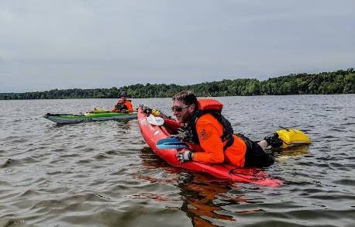
Popularity of Paddle Sports is Growing
Nearly 2 in 5 recreational boaters are paddlers*
  Steady growth in kayak and SUP participation
Knowledge is key to:
  Safety
  Enjoyment
*Outdoor Foundation Outdoor Participation (2021)
Notes:
Nearly two in five recreational boaters are paddlers.
Participation numbers per the report are:
9.199 million canoe
13.351 million recreational kayaking
2.587 million sea kayaking
2.623 whitewater kayaking
3.739 million SUP.
Participation is growing by about a million paddlers yearly, predominately in SUP and kayaks.
Kayak fishing was included as a separate category for several years but no longer is; that added another 3 million paddlers. However, it’s not clear if those numbers now are wrapped into recreational kayaking or separately into fishing.
It also is worth noting that the 2018 National Recreational Boating Safety Survey, produced by USCG and found at https://uscgboating.org/statistics/national-recreational-boating-safety-survey.php, estimates paddling participation could be higher by 5 to 10 million paddlers.
https://outdoorindustry.org/wp-content/uploads/2015/03/2022-Outdoor-Participation-Trends-Report-1.pdf
There is a steady growth in kayak and SUP participation.
Knowledge is key to:
Safety
Enjoyment

Slide 6
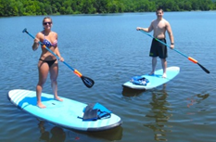
Risk Mitigation
Paddling is generally safe but has risks
Drowning is the most common cause of death
Life jackets save lives (when worn)
Notes:
Text is self explanatory.

Slide 7
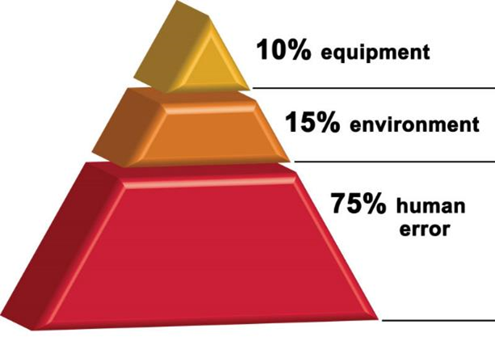
Risk Mitigation
Skills, planning, situational awareness, and proper gear
On-water training and group paddling are fun and enhance safety
Nearly all accidents
are preventable
Notes:
Text is self explanatory.

Slide 8
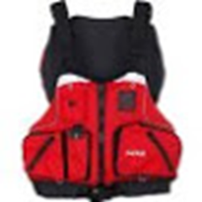
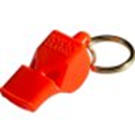

Federal Law Requires
USCG-approved Life Jacket
“Sound producing device”—preferably a whistle attached to the Life Jacket
A “White Light” if on the water after sunset or in reduced visibility
Notes:
INSTRUCTOR: Have these items available for display/demonstration
Yes, your kayak or your SUP is considered a vessel. As such, you must observe some federal requirements out on the water.
While federal law requires that USCG-approved life jackets be worn by those younger than 13, when it comes to paddle sports, EVERYONE should be wearing one. And state laws may be even more restrictive. If the life jacket is not worn, make sure the life jacket is readily available and fits properly.
The same is true of sound devices like whistles or air horns and white light after sunset…not just the law, but common sense. Attaching the whistle to the life jacket is the most efficient method.
Boat registration—varies from state to state; go to http://www.americasboatingcourse.com/lawsbystate.cfm to find your state or schedule a Vessel Safety Check.
Note: If you are in a non-motorized craft, then do not impersonate a motorized craft. If you have red/green port/starboard lights, then at night, other boats will think you are motorized, and the rules of the road are different for motorized and nonmotorized craft. Do not impersonate a motorized boat if you are not motorized.

Slide 9
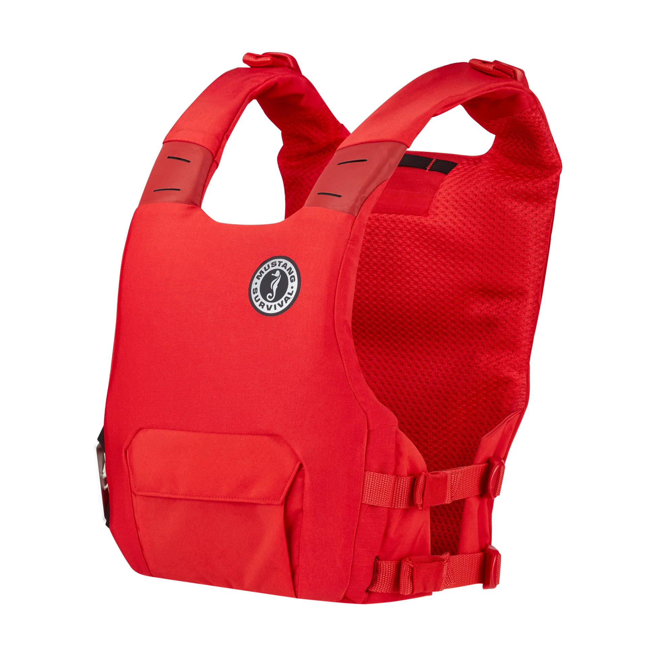
LIFE JACKETS:
A MUST FOR EVERY PADDLER
Need to match activity
Should be worn and properly fitted
Must be worn if younger than 13 or per state law
Bright colors preferred
Know your state laws!
https://www.boatus.org/life-jacket-loaner/state-requirements/#state-holder
Notes:
The life jacket (PFD or personal flotation device) is your most important piece of safety gear. This is a must for every paddler. Capsizes and falls overboard are common among paddlers. Wearing a life jacket dramatically reduces the risk of injury or death. They also provide protection from rocks and other debris. And are used to store emergency gear and add a layer of warmth.
Nearly all fatal paddling accidents are due to capsizing or falling overboard, and most paddlers who drown are not wearing a lifejacket. Those who drown wearing a lifejacket are almost always trapped underwater by debris or stuck in their boat - their chances would have been even worse without the lifejacket.
(Note, the instructor should have properly equipped adult and child PFDs available and on display)
There are different types of lifejackets
There are different types for different activities; choose the right one for you
And they are rated by body weight and size
Look for the USCG approval label and rating
Lifejackets need to be fitted and adjusted appropriately
Bright colors such as red, yellow, or orange enhance visibility and are preferred over blue, olive, or camo
State laws regarding life jackets are sometimes more restrictive; know your local requirements
Life jacket color should contrast with the color of the water and background. Orange is a great color on the ocean but terrible on muddy rivers. Black is terrible on open water but great on muddy water.
Bright colors that contrast with the background and the water, enhancing paddler visibility, are best. In many conditions, orange, yellow, and red are the easiest to see.

Slide 10
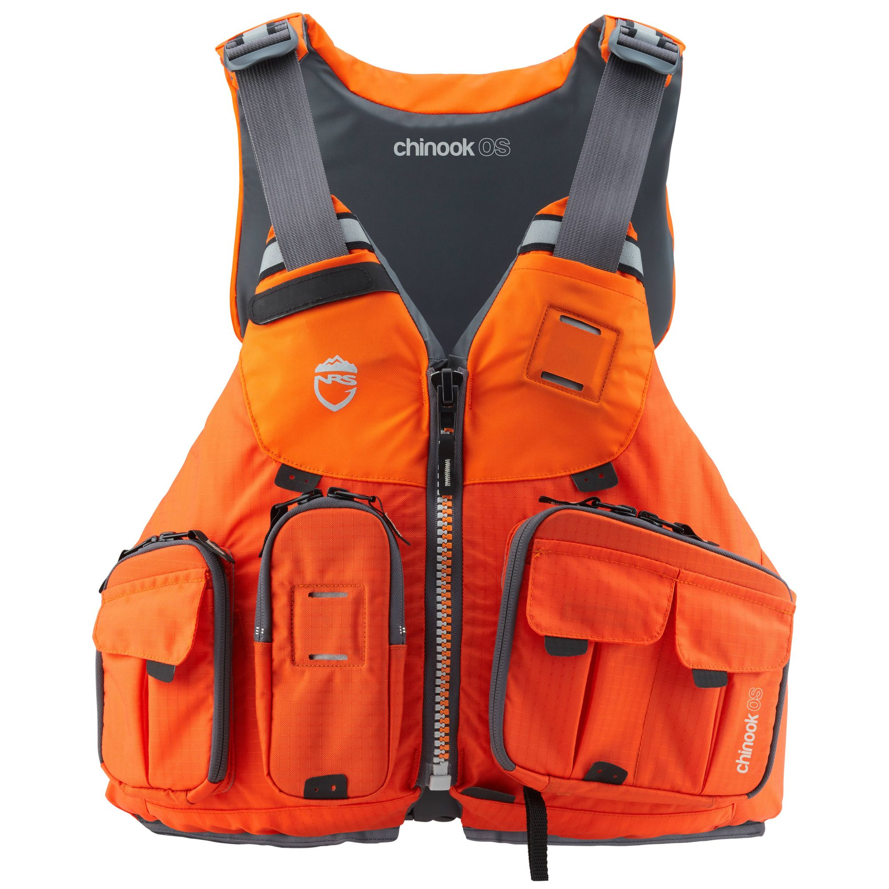
Life Jackets:
Comfort and Fit
Need to be fitted correctly
Comfort - we wear
what is comfortable
Should fit snugly —especially for children
Inflatables are a poor choice
Notes:
THE INSTRUCTOR SHOULD DEMO THE PROPER FIT OF THE LIFE JACKET
Start at the bottom and fasten all the way up until "COMFORTABLY SNUG.” The belly buckle (that everyone skips) is what anchors the PFD below the rib cage.
INFLATABLES ARE GENERALLY NOT APPROPRIATE FOR PADDLESPORTS--ESPECIALLY AUTOINFLATABLES. Belt-type life jackets on SUPs are only legal if worn. Having it on the boat is not enough.
Type III with freedom of movement is generally best
Pockets are a consideration
Belt-pack inflatable PFD is an option for SUPs
Life jackets are even designed for differences in body types and have specific ones for the female body.
Life jackets should fit snugly without shifting while swimming. Children should wear children’s life jackets.
SUP paddlers need a leash connecting them to the board. This ensures they stay connected to the board and its flotation.

Slide 11
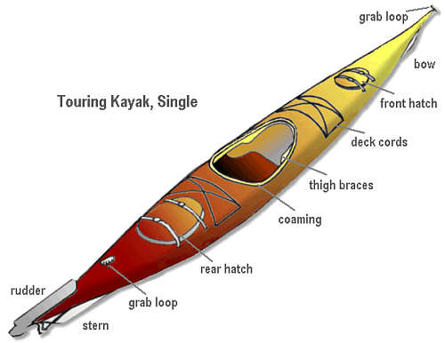
Basic Terminology
Bow/Stern
Beam/Length/Draft/Freeboard
Cockpit/Coaming
Bulkhead
Hatch
Deck/Deckline
Rudder
Port/Starboard
Notes:
Terminology matters. Understanding the features of a particular type of paddlecraft helps you decide if it is the right paddlecraft for YOU. The right language helps eliminate confusion in communication.
Here are some key terms we should be using at various points in the course. (see the list on slide)
This slide shows some common terms for kayaks. Canoes and SUPs also have some common terms specific to their craft, which will be discussed later.
Footrests: these could be molded in plastic (e.g., for sit-on-tops), a foot peg or brace, or an adjustable bulkhead.

Slide 12
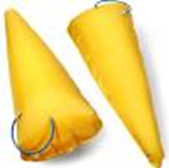
Buoyancy is Critical
How should craft handle when swamped?
  Can I de-water and re-enter?
  Does it have bulkheads and
  do they leak?
  Are hatches secure?
  Can buoyancy be improved with float bags?
Notes:
The most important insight you can have about your paddlecraft is HOW will THIS CRAFT HANDLE WHEN SWAMPED? Will I be able to de-water and re-enter my boat if I capsize?
If it has bulkheads that provide buoyancy, do they leak? Are the hatches secure?
When purchasing buoyancy, most boats have a minimum flotation; this flotation only creates neutral buoyancy. These are closed-cell foam.
You can add inflatable or cell flotation to displace water and decrease the amount of water that could come in when you capsize. This is your most important investment after the boat, paddle, and life jacket.

Slide 13
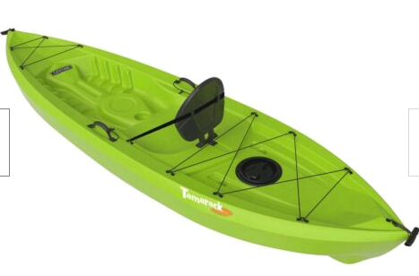
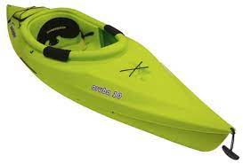
Types of Vessels
Recreational/beginner kayaks
  Sit inside
  Sit-on-top
Notes:
Here is a quick review of kayak types and the advantages/disadvantages of each. Think about why and where you paddle in choosing the boat for you.
A recreational kayak or rec boat is designed primarily for lakes and other still water and fair weather conditions. They are less maneuverable, lack extra buoyancy, and are harder to manage in a capsize.
A sit-on-top kayak is just that; it does not have a decked-over cockpit.

Slide 14
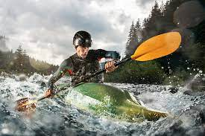
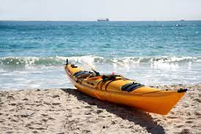
Types of Vessels
Intermediate to advanced kayaks
  Sea kayaks
  White water
Notes:
Here is a quick review of kayak types and the advantages/disadvantages of each. Think about why and where you paddle in choosing the boat for you.
Touring or sea kayaks are designed for open water conditions. They generally are longer and narrower than other kayaks and often have additional features such as bulkheads and rudders.
Whitewater kayaks tend to be shorter, allowing them to turn easily to avoid rocks and other hazards. These boats often have thicker hulls and internal reinforcing to better withstand wear and tear from rocks and rapids.

Slide 15
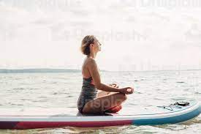
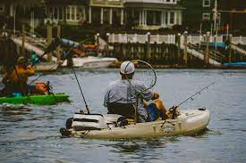
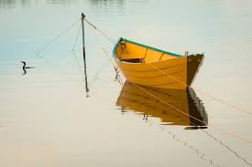
Types of Vessels
Other vessels
  SUPs
  Sit-on-Top/fishing kayaks
  Canoes
Notes:
Here is a quick review of kayak types and the advantages/disadvantages of each. Think about why and where you paddle in choosing the boat for you.
A fishing kayak is specially designed for fishing, typically with upright seats, foot pedals, and other features.
These kayaks tend to be among the most stable of all kayaks because every action a fisherman takes all day will likely set them off balance: casting, landing a fish, turning, sorting through tackle, etc. These kayaks are also heavier than most other kayaks, and fishermen tend to load them down with more gear and entanglement hazards, making re-entry more difficult.

Slide 16
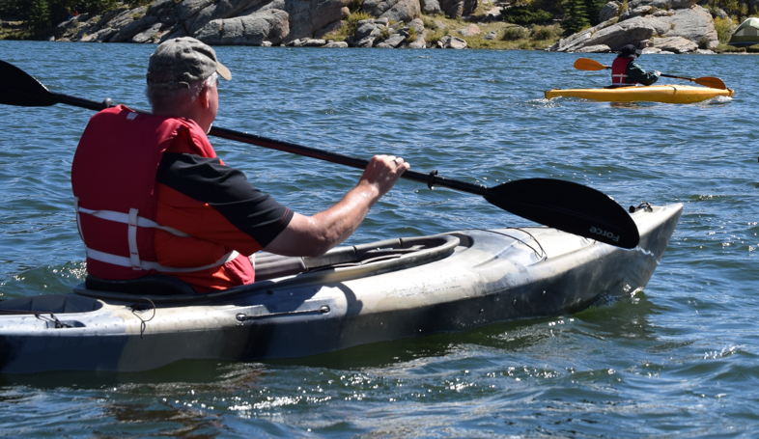
Recreational/Beginner Kayaks
Sit Inside
  Broad beam (stable on calm water)
  Large open cockpit
  Need flotation
  Difficult to dewater and
  re-enter
Notes:
These are the typical “first kayaks” for many paddlers.
Sit Inside and Sit-on-Top kayaks are very affordable and are commonly the first kayak purchased by a new beginning paddler.
These kayaks are satisfactory for short trips on calm water—but not designed for longer trips as their broad beam limits their speed and requires more effort.
Sit Inside recreational kayaks can present a particular hazard – they generally have limited flotation and no bulkheads to ensure buoyancy.
Sit Inside kayaks can be very difficult to dewater when swamped—especially when attempting a self-rescue. However, sit inside kayaks also offer more protection from the elements in the shoulder seasons if one paddles year-round.

Slide 17
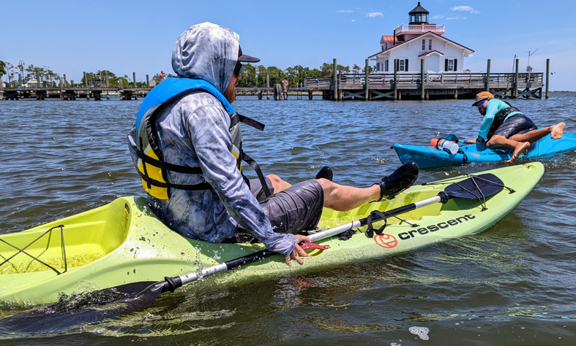
Recreational/Beginner Kayaks
Sit-on-Top
  Broad beam (stable on calm water)
  “Unsinkable” (does not flood easily)
  Easy to re-enter
Notes:
These are the typical “first kayaks” for many paddlers.
Sit-on-Top kayaks are very affordable and are commonly the first kayak purchased by a new beginning paddler.
These kayaks are satisfactory for short trips on calm water—but not designed for longer trips as their broad beam limits their speed and requires more effort.
Some SOTs are designed as high-performance craft. These are much more expensive than entry-level SOT and often have features found in high-end sea kayaks or whitewater kayaks.

Slide 18
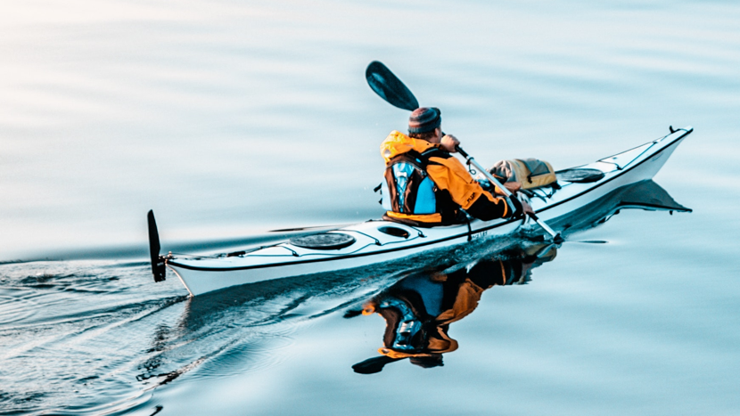
Intermediate to
Advanced Kayaks
Sea Kayaks
  Longer, faster
  and more tippy
  Cover longer
  distances
  Bulkheads provide flotation
  Need skill to re-enter
Notes:
These are more advanced.
Sea Kayaks
– Longer, faster, and often more tippy than recreational kayaks
– Cover longer distances
– Bulkheads provide flotation
– Need skill to re‐enter

Slide 19
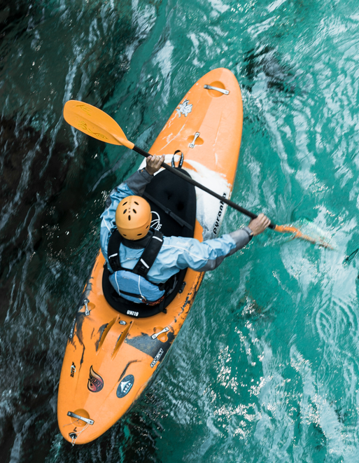
Intermediate to
Advanced Kayaks
White water
  Short and maneuverable
  Re-entry typically involves
  going to shore
  Moving water is
  hazardous
Notes:
These are more advanced.
• White water
– Short and maneuverable
– Re‐entry typically involves going to shore
– Moving water is hazardous

Slide 20
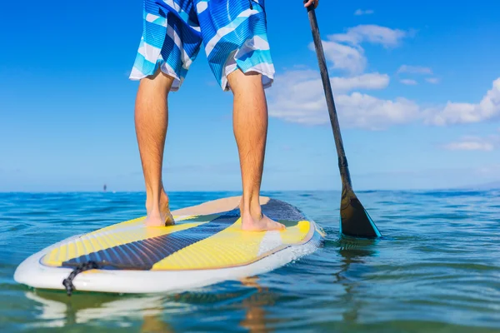
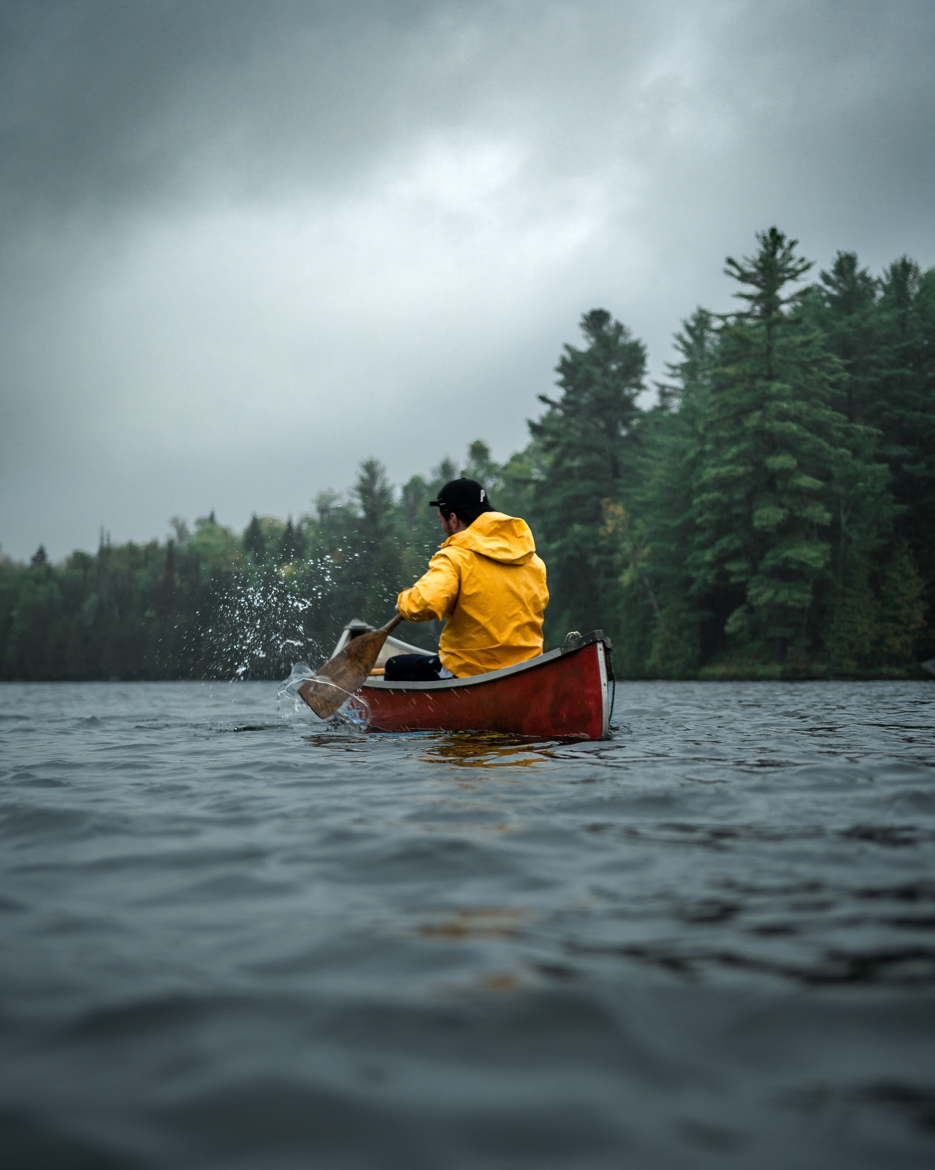
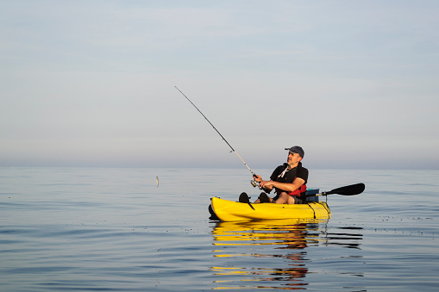
Other Vessels
Addressed Later
SUPs
Fishing Kayaks
Canoes

Slide 21
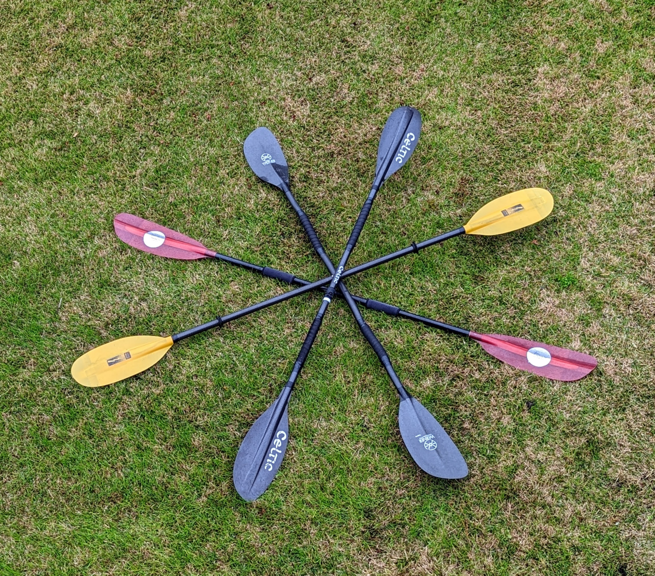
The Paddle
Notes:
INSTRUCTOR NOTE: The instructor should have one or more paddle types on hand for illustration
Of course, you need a paddle. In fact, we recommend carrying a spare.
Paddles vary in length, weight, and other characteristics. Choose a paddle of the right length that is comfortable for you.
And hang onto your paddle if you paddle—even when you capsize.
Hold onto the shaft. Use the power-face of the blade to catch, power through, and release the water with each stroke. There is no need to turn the paddle blade around to paddle backward. Typically, hold the paddle with the curved paddle (the bowl of the spoon) facing the paddler and the longer edge across the top.

Slide 22
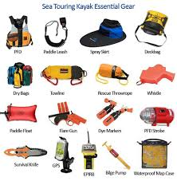
Other Gear
Depending on circumstances:
De-watering
pump
Paddle float
Spare paddle
Tow gear
Notes:
INSTRUCTOR NOTE: Have an array of recommended gear on display that represents what is in the illustration; talk selectively about those pieces most connected to the present audience.
There is a wide array of gear appropriate to a wide variety of conditions. Four items in addition to those we have discussed so far to consider are these (slide.)
MOST IMPORTANT, HOWEVER. And we should talk about this more… is PLANNING YOUR PADDLE TRIP and EQUIPPING accordingly.
Consider adding a reentry sling or line to the standard equipment.
Then, practice with the rescue equipment, especially reentry.
It is important to understand the difference between river gear and gear that is appropriate for open water.

Slide 23
REVIEW/QUESTIONS SECTION I
Hopefully, one of your takeaways is that safety is a CONSCIOUS process involving knowledge and behavior.
What are some of the information you have learned so far that should help you be a safer paddler? What are some of the behaviors that you should adopt to increase safety?
Notes:
INSTRUCTOR NOTE: This content is meant to help with recall, foster interaction, and measure mastery of learning objectives.
It is time to check in on what you have learned. I have a few questions for you.
1, Hopefully, one of your takeaways is that safety is a CONSCIOUS process involving both knowledge and behavior. What are some of the information you have learned so far that should help you be a safer paddler? What are some of the behaviors that you should adopt to increase safety?

Slide 24
REVIEW/QUESTIONS SECTION I
2. What is the best type of life jacket for the paddle sport you do? How do you wear it correctly?
3. What are some of the advantages and disadvantages of the paddle craft that you use?
Notes:
INSTRUCTOR NOTE: This content is meant to help with recall, foster interaction, and measure mastery of learning objectives.
2. What is the best type of life jacket for the paddle sport you do? How do you wear it correctly?
3. What are some advantages and disadvantages of the paddle craft you use?

Slide 25
REVIEW/QUESTIONS SECTION I
4. How can you ensure the buoyancy of your kayak?
5. What are some of the other safety equipment you could carry?
Notes:
INSTRUCTOR NOTE: This content is meant to help with recall, foster interaction, and measure mastery of learning objectives.
It is time to check in on what you have learned. I have a few questions for you.
4. How can you ensure the buoyancy of your kayak?
5. What are some of the other safety equipment you could carry?

Slide 26
Stages of a Trip
1. PLANNING AND PREPARATION
2. ON THE WATER
3. AFTER YOUR TRIP
Notes:
There are three main stages of any paddling trip.
THE MOST IMPORTANT IS PLANNING AND PREPARATION
THEN, handling yourself and your group out on the water.
And what you do AFTER the trip should impact safety the next time!
Let’s take a look at each.
Important: Need to emphasize boat ramp etiquette at put in and take out.

Slide 27
1. PLANNING AND PREPARATION
Venue/route and water conditions
Weather: wind, air, and water temperature, lightning
Checklist for gear
Communications
Float plan
Go/no-go decision
Notes:
Text self-explanatory, focus on the importance of an informed go/no go decision.

Slide 28
Trip Planning
Match skills to venue, conditions, distance
Paddle with friends—it is safer
Check the weather
Know access points for alternative takeout
Plan for a capsize
Notes:
Trip planning is where the enjoyment and the safety begins.
INSTRUCTOR NOTE: Be mindful of adapting this content to local conditions and to the types of paddling the audience told you they do at the start of the session.
Always consider paddling with friends; it is safer.
Next, choose a venue that fits your skills, equipment, and fitness level. Weather is always a factor. (Around here, you may also want to consider tides, boat traffic, etc.)
To check the weather, go beyond general forecasts when applicable, as marine and mountain conditions can vary greatly.
Check water conditions - this might include river levels, tides, and wave forecasts.
Plan your put-in and your route: where should you start, and what conditions, hazards, etc., will you encounter? (Discuss with as many local references as possible using guidebooks, websites, other paddlers, etc.) Is your trip an out and back: if so, will wind/tide affect your return?
Inventory your gear well before the trip. We recommend having a checklist.
Once you are all set, develop and file an appropriate float plan for your trip.

Slide 29
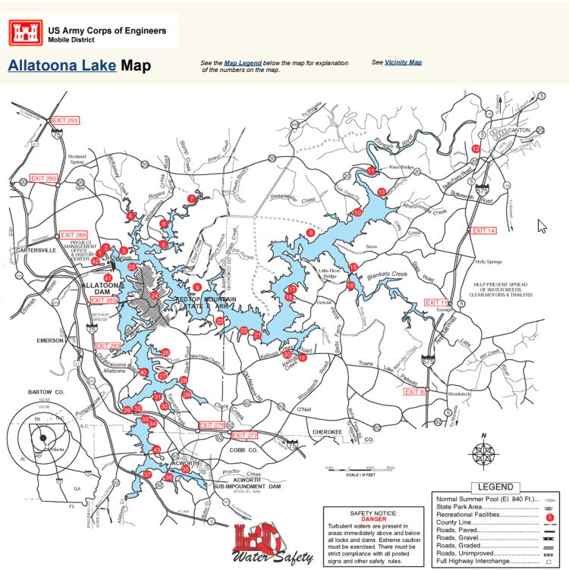
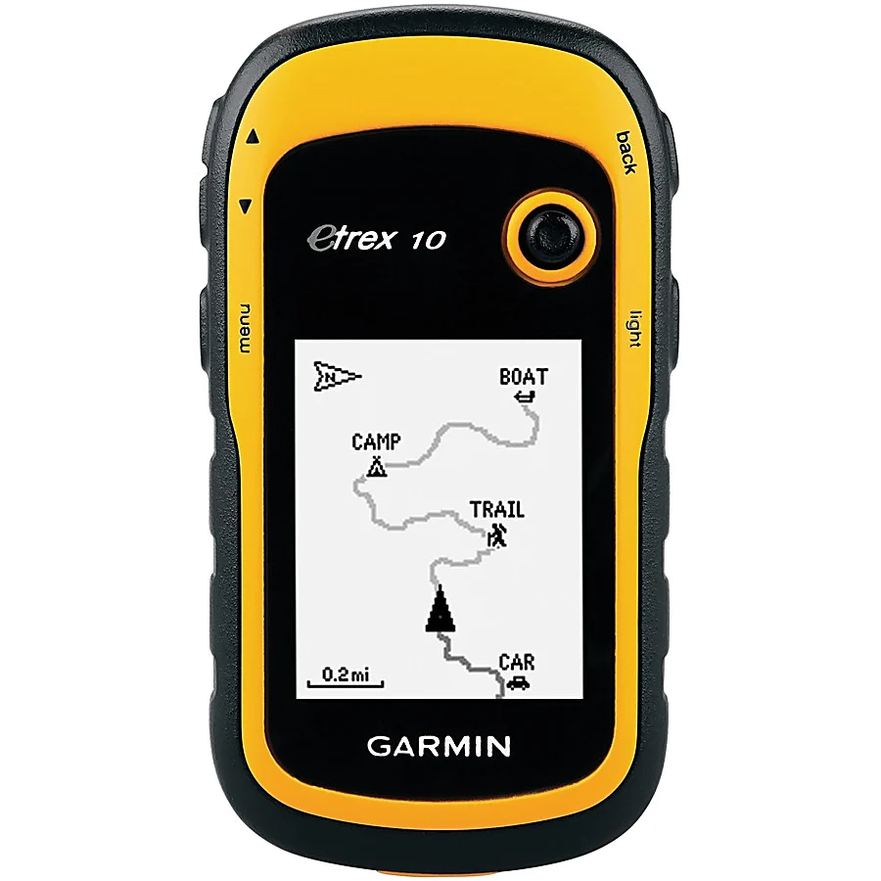
Planning the Venue/Route
Guidebooks/websites
Marine charts
GPS
Notes:
Consult a guidebook, website, marine chart, or inland map to learn about where you intend to paddle. Remember that conditions change over time, and these guides may not be 100% accurate. These references should often have information about parking, put-in/take-out points, distances, local conditions and hazards, and more. You can also consult marine charts (now going electronic) and your GPS to learn more about your intended route.
NOAA charts are available at: https://nauticalcharts.noaa.gov/enconline/enconline.html. Many harbor charts are a good scale for paddlers, as well as chart books, which can print onto 8 1/2 x 11 paper and be laminated to carry afloat. Marine radios may also have a GPS and chart.
It is important to research the appropriate USGS gauge to look at the water level on the section of the river one is paddling in and has enough local intel to know what numbers to look for on the gauge to know if it is safe to paddle today.
USGS river gauges can be found at https://waterdata.usgs.gov/nwis/rt.
American Whitewater’s river info page https://www.americanwhitewater.org/content/River/view/river-index shows current water levels of many rivers (from the USGS data), provides information about the river, including recommended levels, and gives access information.

Slide 30
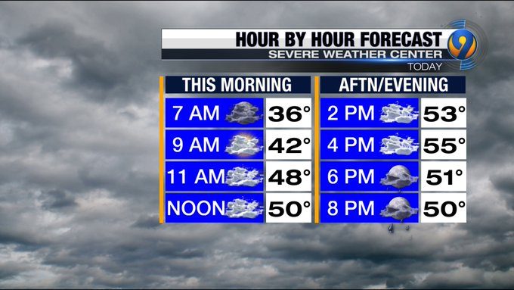
Planning for Weather
Marine and local forecasts
Wind may dictate a change of venue
Heat and cold
Storms and lightning
Weather is changeable!
Notes:
Marine weather and lake weather, especially in mountainous regions, can vary greatly from generalized regional forecasts. Check NOAA marine forecasts and local lake forecasts before you head out. Understand the risks of changes in wind, storms, and temperature changes. Remember, weather is changeable; afternoon conditions may not look like those in the morning.
INSTRUCTOR NOTE: Provide local examples, e.g., in many NE communities with south-facing coasts, calm mornings can turn into very windy afternoons.

Slide 31
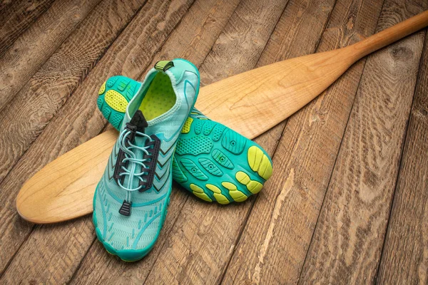
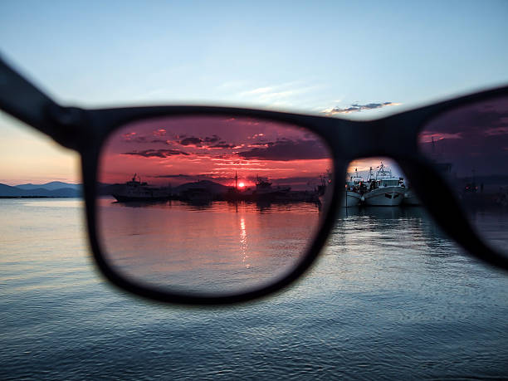
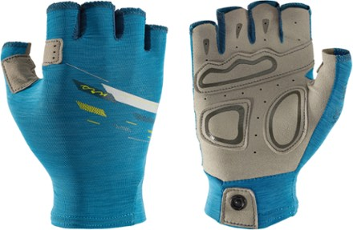
Planning:
Dressing for Weather and Water
Paddle shoes
Sunscreen/
sunglasses
Paddle gloves
Notes:
Paddle shoes should be closed-toed and fastened. Clogs and crocs that fall off don't work if you have to get out in shallow water and push.

Slide 32
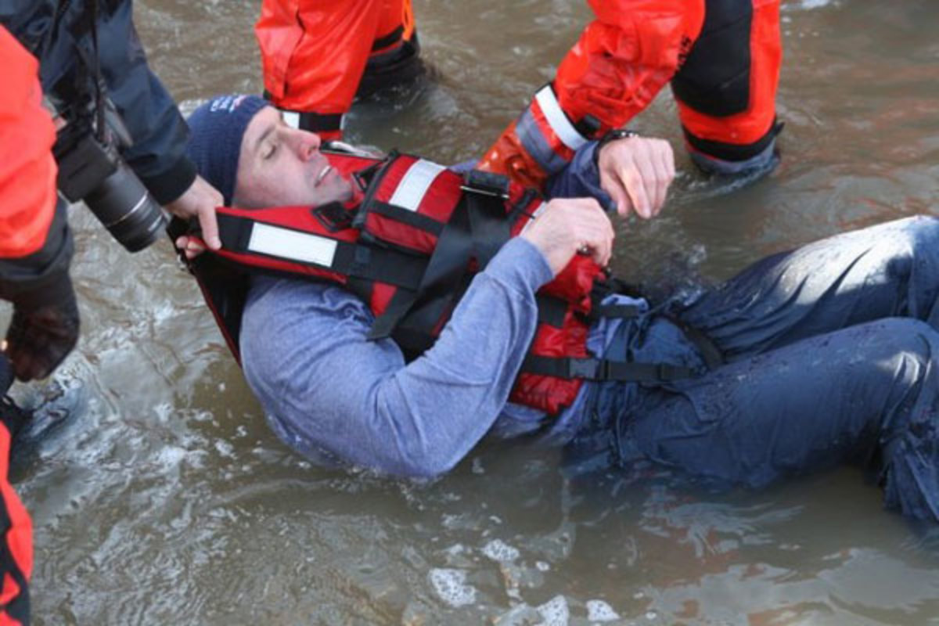
Planning:
Dressing for the Water
Cold Shock Response
(Cold Shock, Cold Water Shock)
Immediate, reflexive response
Typically lasts one to five minutes
Colder water = higher risk of occurring
Rapidly reaches maximum effect
Notes:
Cold water immersion can be immediately life-threatening. All boaters are encouraged to dress for water temperature (additional details on following slides). There are four major cold water immersion health issues. They can occur in water as warm as 70 F but are more likely to occur in colder water.
Cold Shock (also called the Cold Shock Response) – this happens immediately after immersion. Subjects gasp reflexively (potentially causing them to inhale water). Their respiratory rate, pulse and blood pressure all climb precipitously. Breath holding capacity decreases dramatically. Fear and panic are common. Cold shock response typically last for a few minutes, although the subject may feel like this is much longer. Subjects should focus on getting to the surface, floating on their and trying to control their breathing until the acute problem passes. Wearing a life jacket helps ensure subjects can float. Dressing for the water temperature, so the skin isn’t exposed to cold, can help prevent cold shock.
The best way to handle cold immersion is to not enter the water when it is cold. If you do enter the water, dressing for the water conditions and wearing a life jacket make a tremendous difference, potentially adding hours of time for rescue.
More information on cold water immersion is available at http://www.coldwaterbootcamp.com/pages/home.html. Extensive information on these topics is available at http://wow.uscgaux.info/Uploads_wowII/B-DEPT/Cold_water_immersion___beyond_hypothermia.pdf.
INSTRUCTOR NOTE: Refer to local conditions and typical/seasonal wind/water contrasts.

Slide 33
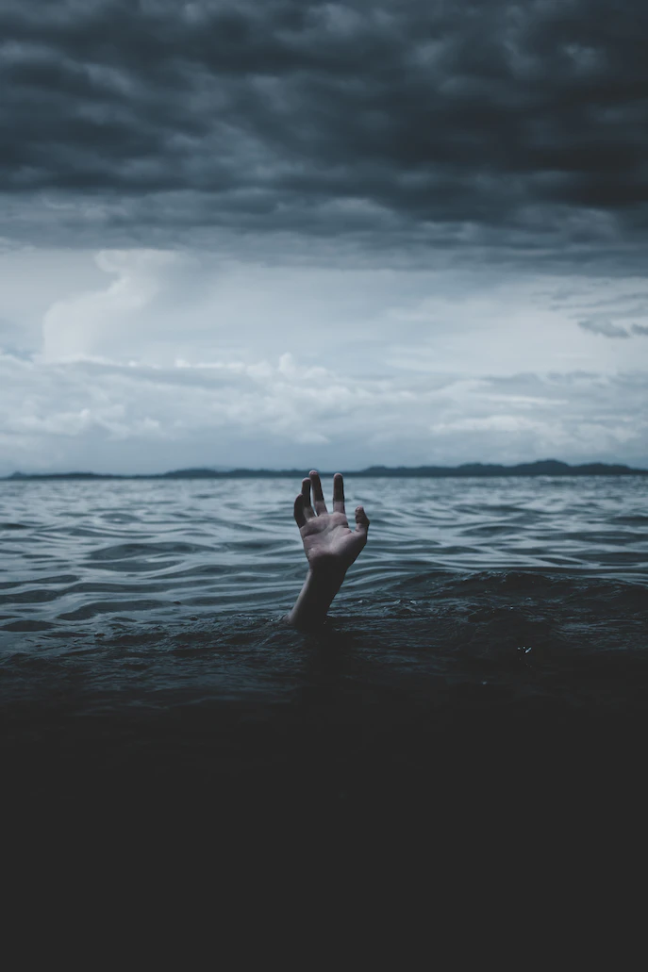
Planning:
Dressing for the Water
Cold Incapacitation
Extremities cool and lose function
Swim failure – 10 minutes
Motor skills loss
No PFD = Drowning
Notes:
Cold Incapacitation – this happens as muscles in the extremities cool and stop functioning. It initially affects small muscles, leading to poor fine motor control. Eventually, it affects large muscles and leads to swim failure. Swim failure can develop in as little as ten minutes in very cold water. Subjects should attend to important activities such as activating PLBs, calling for help, or righting the boat and getting back in as soon as they can, while they can. Wearing a life jacket and dressing for water temperatures prolongs the time a subject stays afloat until cold incapacitation and swim failure develop.
The best way to handle cold immersion is to not enter the water when it is cold. If you do enter the water, dressing for the water conditions and wearing a life jacket make a tremendous difference, potentially adding hours of time for rescue.
More information on cold water immersion is available at http://www.coldwaterbootcamp.com/pages/home.html. Extensive information on these topics is available at http://wow.uscgaux.info/Uploads_wowII/B-DEPT/Cold_water_immersion___beyond_hypothermia.pdf.
INSTRUCTOR NOTE: Refer to local conditions and typical/seasonal wind/water contrasts.

Slide 34
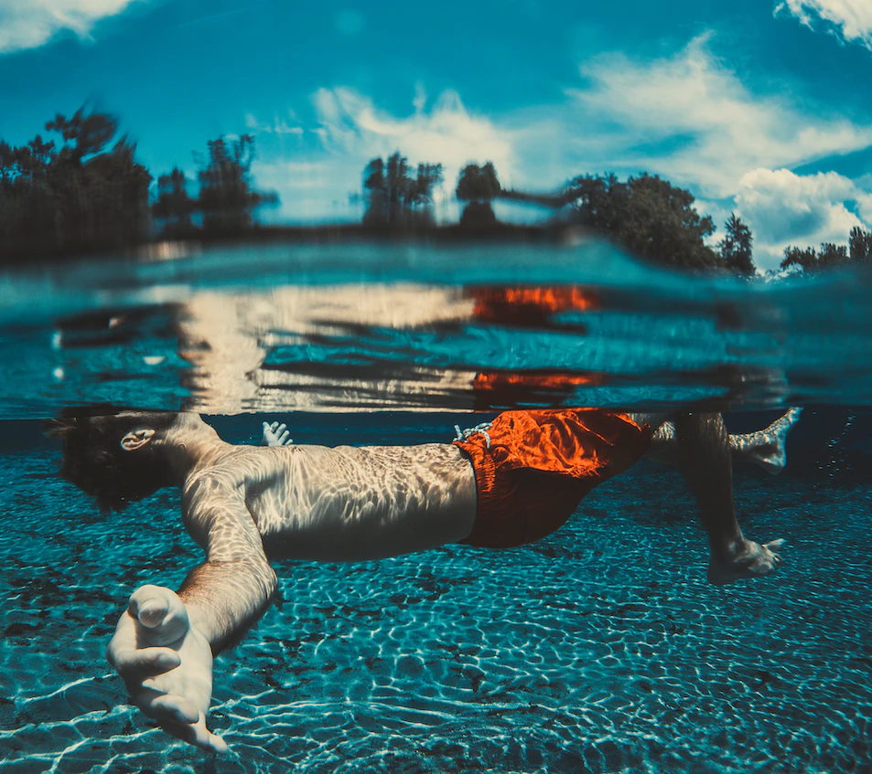
Planning:
Dressing for the Water
HYPOTHERMIA
  Core body temperature = 95⁰F or lower
  Three Stages
    Mild
    Moderate
    Severe
Notes:
Hypothermia – this occurs when the body’s core temperature drops to 95 F or below. Subjects typically lose good judgment, begin to shiver, and may show the “umbles” - fumbling, mumbling, bumbling, grumbling, and stumbling. Later, as their body temperature continues to drop, their level of consciousness declines, and they eventually lose consciousness. Without some type of flotation, subjects will sink and drown. It generally takes an hour or more for subjects to become unconscious, so rescuers and victims should not give up hope when someone enters the water. Wearing a life jacket and dressing for water temperatures helps ensure the subject stays afloat and prolongs the time until hypothermia develops.
INSTRUCTOR NOTE: Refer to local conditions and typical/seasonal wind/water contrasts.

Slide 35
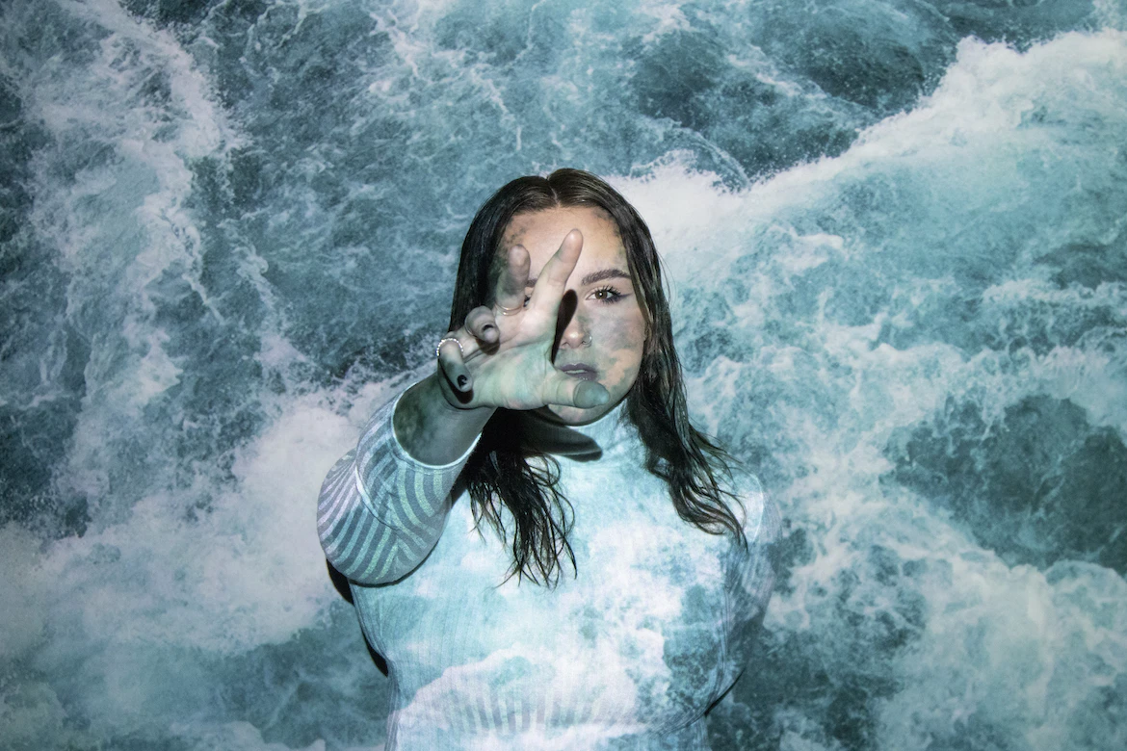
Planning:
Dressing for the Water
Circum-rescue Collapse
  Collapse around the time of rescue
  Ranges from fainting to cardiac arrest
  Loss of hydrostatic
  pressure
  How to treat
  circum-rescue
  collapse?
Notes:
Circum-rescue Collapse – this is a condition where rescued subjects collapse as cold blood in the extremities returns to the body’s core. Rescuers should ensure rescued subjects stay flat until properly assessed and should be prepared for the subject’s conditions to worsen after rescue. Boaters likely to see cold water conditions should seek out medical training that includes treatment of circum-rescue collapse.
Dr. Gordon Giesbrecht, one of the world’s best-known experts in cold water immersion conditions, proposed the 1-10-1 rule to help remember the time frames for each of the conditions above. Suddenly immersed subjects can expect to suffer one minute or more of cold shock. Within as little as ten minutes, they might suffer from cold incapacitation and swim failure. After one hour or more, significant hypothermia symptoms could develop. This rule helps remind boaters that even in dire circumstances, they have time to react and to be rescued.
The best way to handle cold immersion is to not enter the water when it is cold. If you do enter the water, dressing for the water conditions and wearing a life jacket makes a tremendous difference, potentially adding hours of time for rescue.
More information on cold water immersion is available at http://www.coldwaterbootcamp.com/pages/home.html. Extensive information on these topics is available at http://wow.uscgaux.info/Uploads_wowII/B-DEPT/Cold_water_immersion___beyond_hypothermia.pdf.
INSTRUCTOR NOTE: Refer to local conditions and typical/seasonal wind/water contrasts.

Slide 36
Planning:
Dressing for the Water
Recipe for Disaster: Warm day, cold water, paddling alone
Kayaking PFD, sun protection, and
warm weather clothing.
Notes:
The chart is self-explanatory, linking proper dress by water temp.
The figure shows the guide used by Coast Guard personnel to determine what to wear. Paddlers often wear splash gear (basically a rain jacket and pants) in milder conditions and a wetsuit or drysuit in colder conditions.
Olympic pools are 78-82 F
Cold water is defined as 70 F or less
Temperature decreases, risk increases
Cold water can be immediately life-threatening – unless you’re prepared.
In some parts of the country, water temperature seldom rises above 65 degrees F.
Hyperthermia is a huge problem for paddlers, as well as hypothermia. Hydration, sunscreen, and a hat are preventive measures, as well as not going out too far or too long on a summer day.

Slide 37
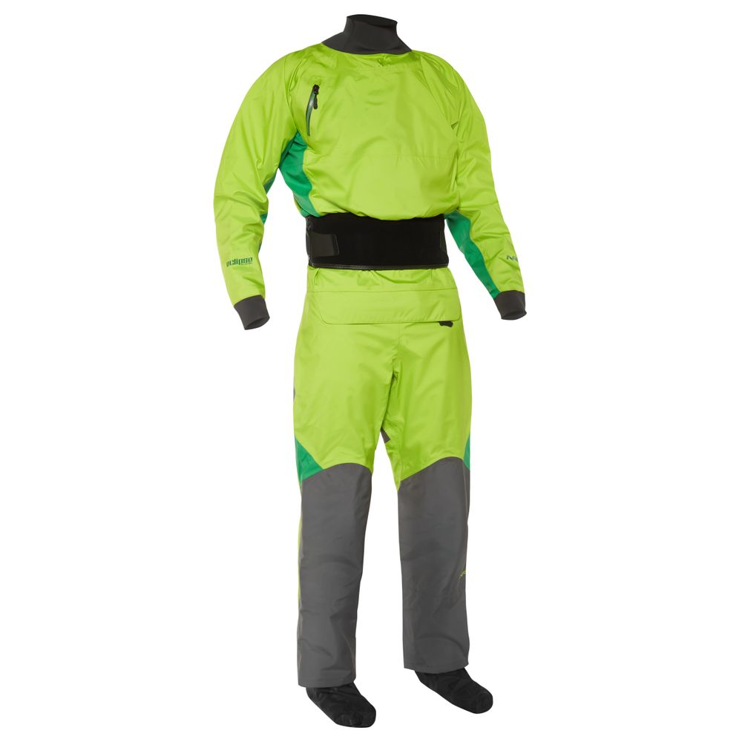
Clothing Options
Strengths and limitations
Drysuit
Waterproof and windproof
Vary layers of insulation, allowing use over wide temperature ranges
Perfect for frequent immersion
More fragile than wetsuits
Notes:
Drysuits are expensive but many people report they provide the greatest flexibility for repeated immersion. Varying the amount of insulation means they can be used comfortably in surprisingly warm conditions. However, they become much less effective if they are damaged, and require more maintenance than other types of insulation.
Semi drysuits are less waterproof because they use neoprene rather than latex neck and wrist gaskets, but that also may make them more comfortable for long term use.

Slide 38
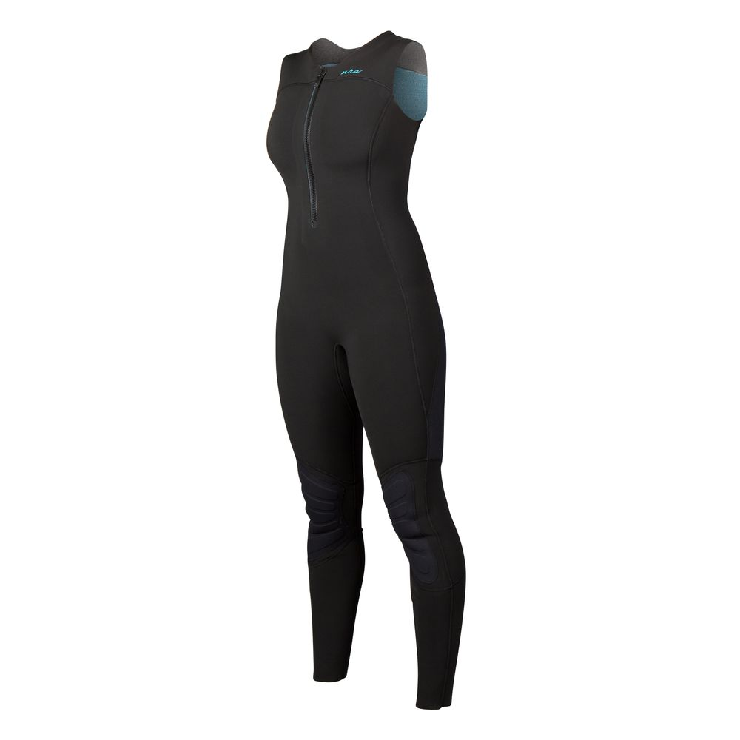
Clothing Options
Strengths and limitations
Wetsuit
Varying weights
Varying coverage (full, farmer john, shorty, …)
Provides padding, flotation and impact protection
Less protection from convective heat loss
Notes:
Wetsuits by trapping air and water. In addition, they must fit snugly to work most effectively. A wetsuit that fits correctly while you’re sitting won’t fit as well while you’re standing or swimming. Wetsuits are generally less expensive than drysuits. Farmer john style wetsuits will help protect the core, but provide no protection for the arms, making cold incapacitation more of an issue.

Slide 39
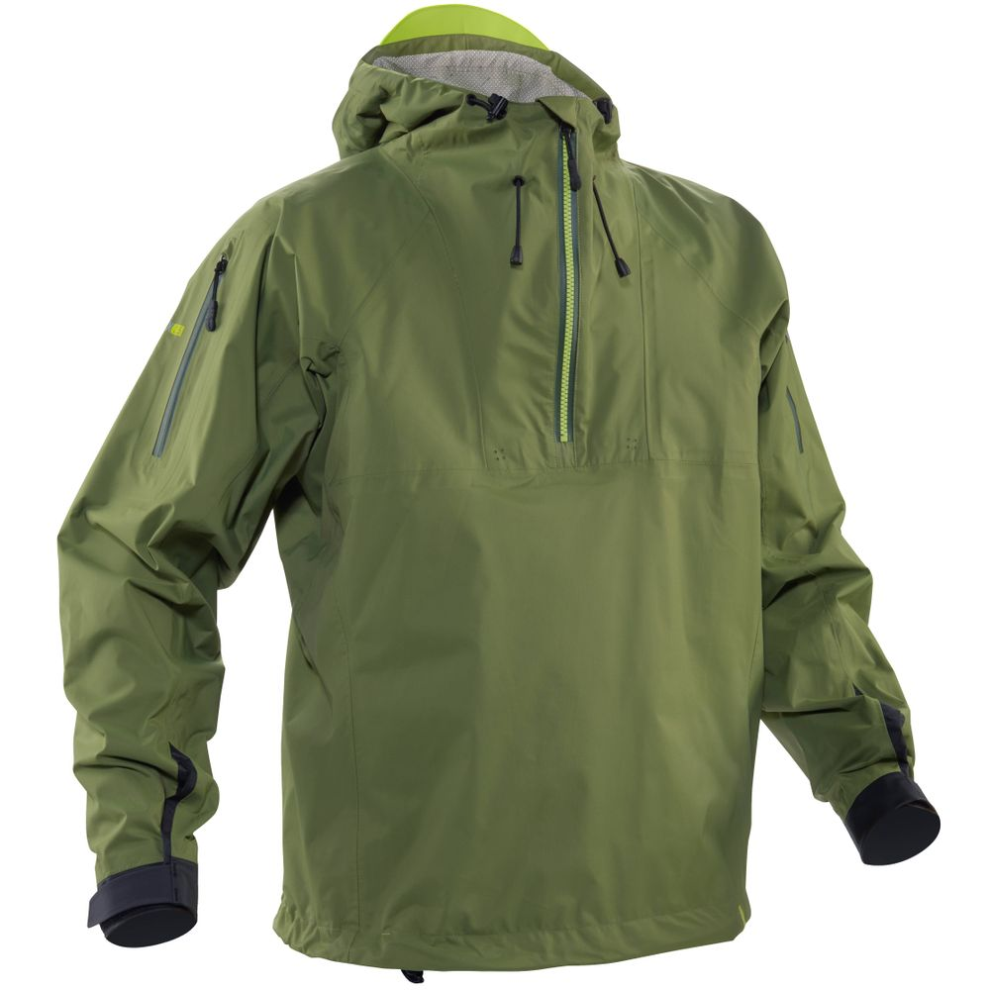
Clothing Options
Strengths and limitations
Splash Gear
Lightweight foul weather gear
Vary amount of underlying insulation based on conditions
Not as warm as other options
Only appropriate for milder conditions
Notes:
Some splash gear uses Velcro tightened wrist and neck closures, and even waist closures. Splash gear includes everything from lightweight rain jackets to full on foul weather gear. Lightweight gear may be more comfortable in moderate conditions, and may be more comfortable protecting boaters from air temperature. They are reasonable choices for a limited range of conditions. They provide little or no inherent insulation but by adding synthetic or wool insulation, or using them in combination with neoprene, they often are effectively used in milder conditions. Practice with this type of gear is important – paddlers may be waterlogged after swimming, and paddling with sleeve full of water can be challenging.
Many paddlers use combinations of gear. Neoprene pants combined with fleece and a dry top or a splash jacket and fleece over a farmer john wetsuit provide effective insulation, but not as effective as a drysuit. Trying your gear out and seeing what works under different conditions will help provide the information needed to wisely choose protective clothing.

Slide 40
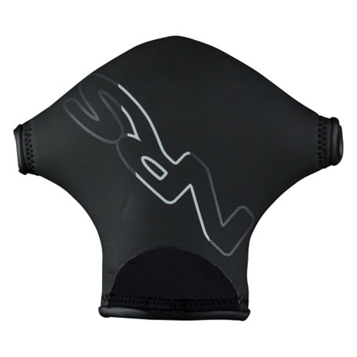
Hand Protection
Options include
pogies, gloves,
and mittens
Mittens and
gloves - neoprene
Thicker material = more protection
Thicker material = harder to hold a paddle
Notes:
Options include pogies, gloves and mittens
Pogies are mittens that wrap around a paddle shaft, allowing bare skin contact with the paddle
Many paddlers find these the warmest and most comfortable
For mittens and gloves, neoprene is a good choice
Thicker material provides more protection
Thicker material makes it harder to hold a paddle

Slide 41
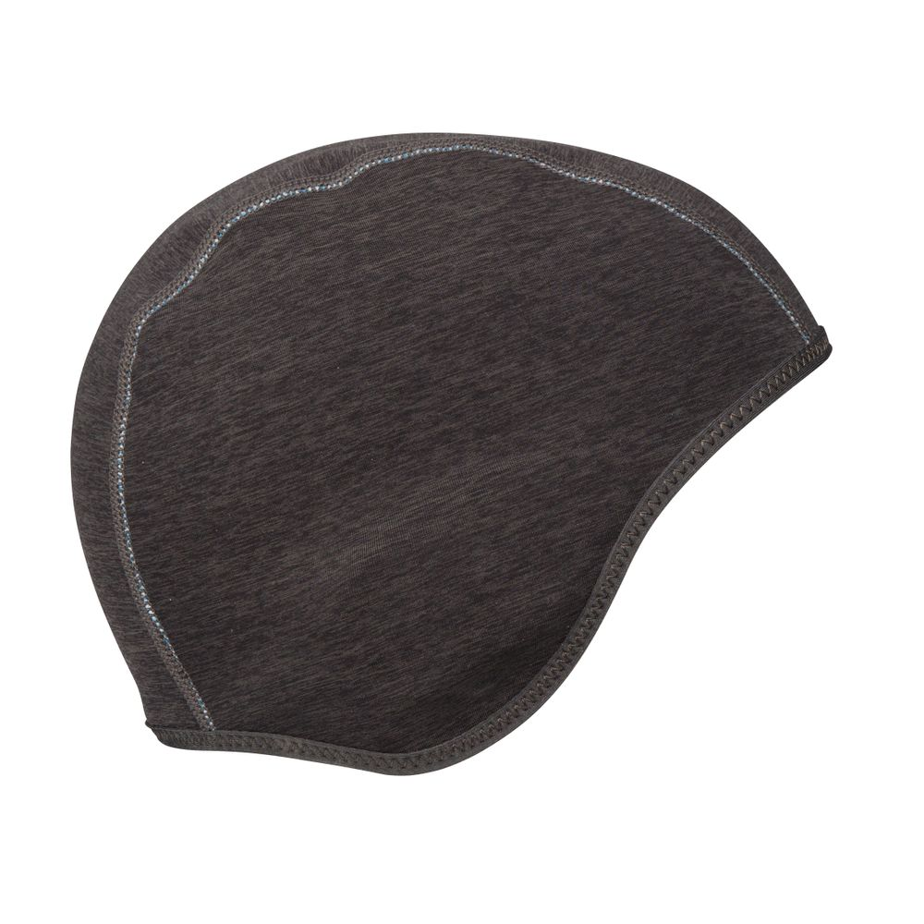
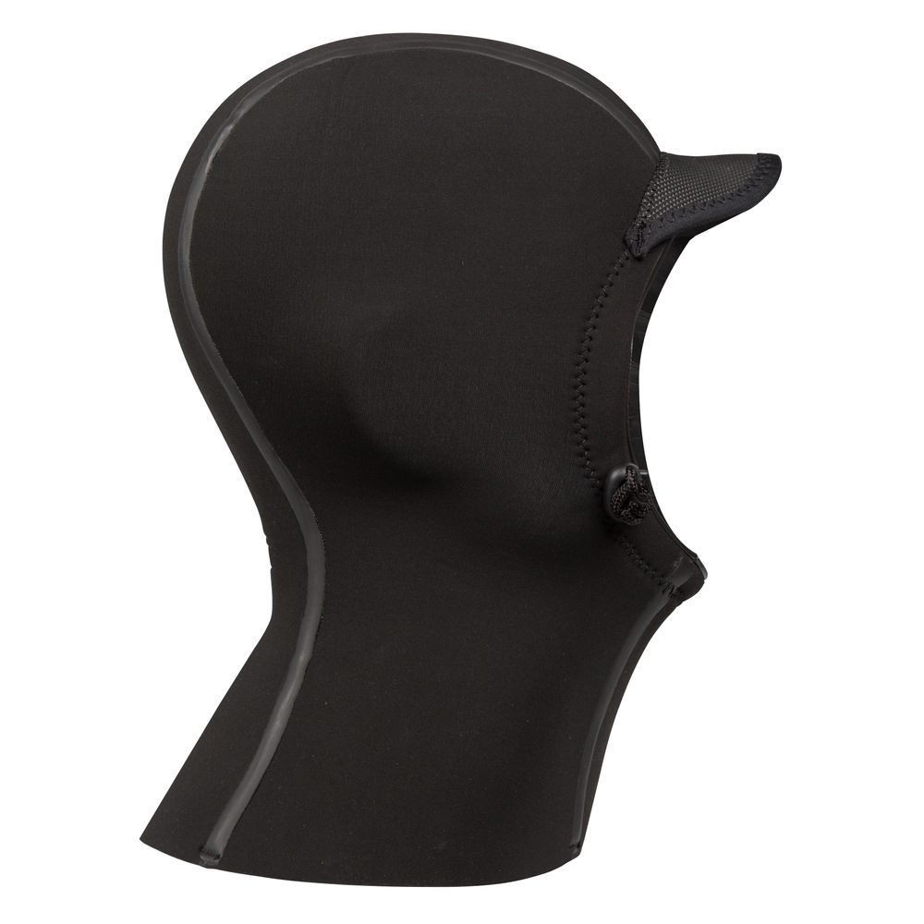
Head Protection
Notes:
Options include simple hats, some of which are designed to fit under helmets and full hoods.
Neoprene is an excellent option. Wool hats are thicker but also work.
Fleece is warm but not windproof – a second windproof layer is needed. Fleece can work well under a helmet.
Shower caps can be used as inexpensive windproof layers and vapor barrier layers.

Slide 42
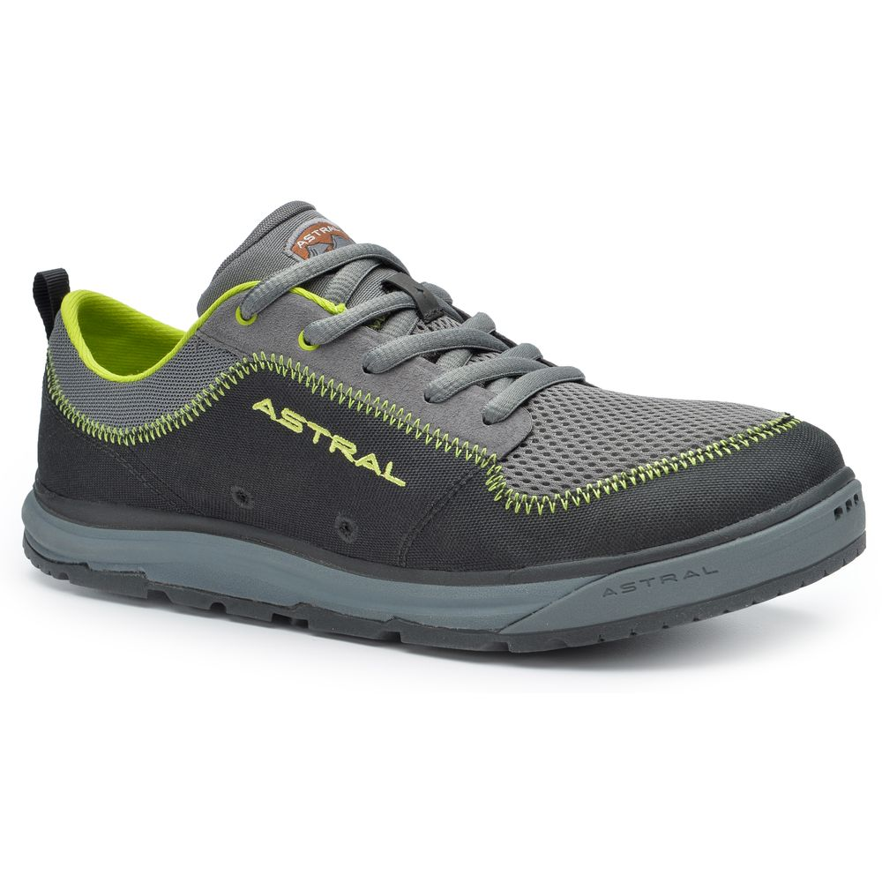
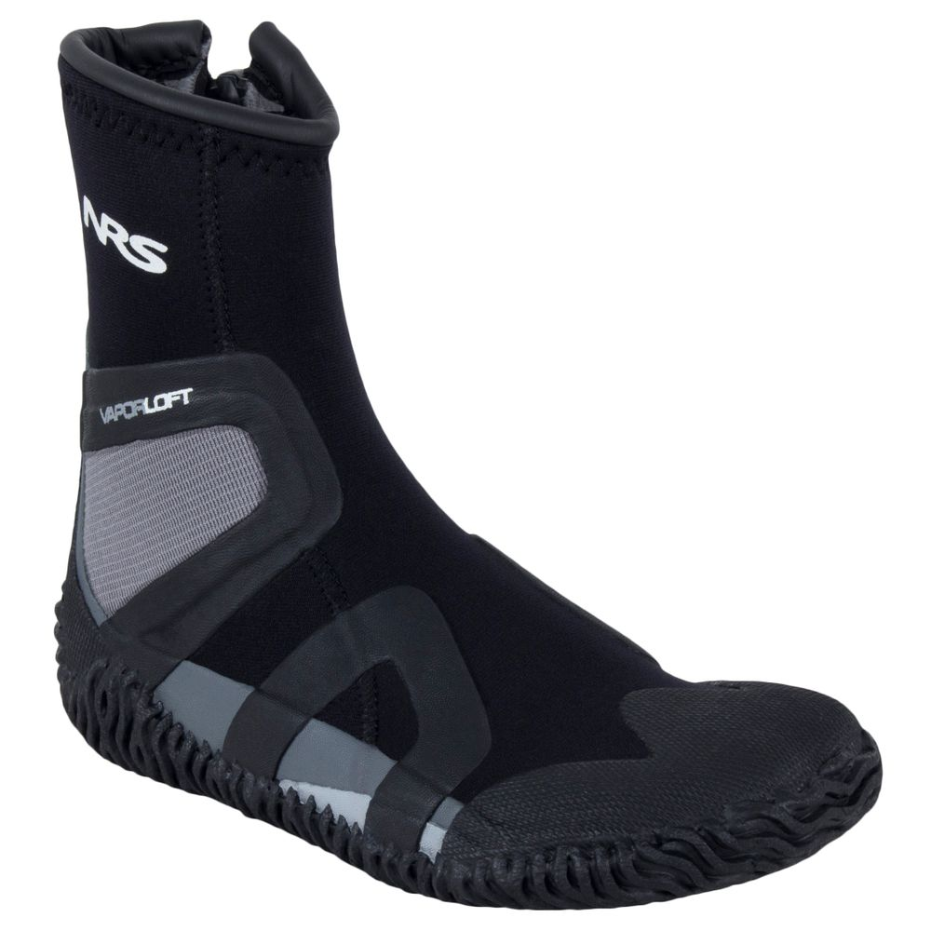
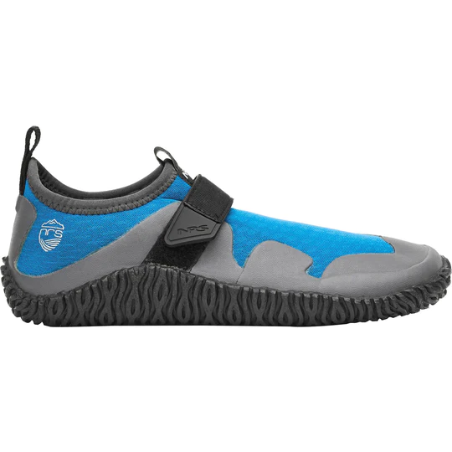
Footwear
Notes:
Scuba style neoprene shoes are warm, durable and inexpensive
Boating shoes require additional insulation, such as wool socks. Make sure the shoe fits after adding extra insulation – you may need to move shoes size up one or two sizes to provide room for the insulation.
Footwear should be secure and should stay on the feet while swimming. Footwear will protect the feet from friction while in the boat, and protect them from rocks, shells and other sharp debris once you reach shore.

Slide 43
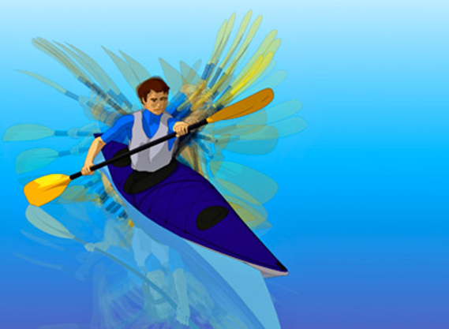
Planning for Visibility
Clothing
Paddle Flash
Reflectors
Motion
Notes:
Visibility
* Maximize your visibility through color and contrast
* Bright clothes, life jackets, and boats are easier to see
* Carry a bright white light if there is any chance you may paddle at night or in reduced visibility
* Consider carrying bright or reflective flags to increase visibility/paddle reflectors
* Your paddle should glint—that should be the first thing an oncoming boat will likely see. Second is the motion of the paddle. The paddler is third.
INSTRUCTOR NOTE: SHARE SILVER DECALS

Slide 44
Planning Checklist
Develop your own checklist to fit your circumstances:
  Inspect Paddlecraft and Paddle
  PFD and Safety Equipment
  Your Personal Needs
  Dressing for Weather and Water
  Maps and Communications
Notes:
INSTRUCTOR NOTE: This is a possible handout, checklist/laminated checklist with room for personal additions. Use this checklist to ensure everything is on hand and in good working condition before heading out. Your paddlecraft; your safety equipment; route finding; your personal needs; dressing for the weather and water. Make sure you have appropriate charts, maps, and directions.
Here is a kayaking and kayak fishing sample checklist from our national B Directorate website:
Kayak—check for leaks in the hull and cracks or tears in hatch seals and gaskets. Make sure the drain plug is properly in place if any. Check deck lines for wear and tear.
Paddle (1 per paddler), plus spare
Life jacket (1 per paddler) with attached whistle
Flotation bags—inflated and installed
Spray skirt
Dry bags (for gear organization)
Weather/VHF radio
Signaling devices (whistle, mirror, flares, or distress flag)
Headlamp or flashlight (with extra batteries)
Towline/floating throw line (with throw bag)
Paddle leash
Paddle float
Bailer or bilge pump
Sponges
Maps and charts in a waterproof case
Compass—hand-held or mounted
GPS
Personal Locator Beason (PLB)
Matches/lighter/fire starter in waterproof container
Knife or multi-tool
Cell phone in protective bag
Multifunction watch
First-aid supplies
Sunglasses
Sunscreen
Lip balm
Water bottles (filled half way)
Energy food (bars, gels, trail mix)
Beverages, non-alcoholic
Sealant
Spare foot peg
Bailing wire (copper, small roll)
Nylon cord (or bungee cords)
Putty
Replacement nuts/bolts
Repair/duct tape
Note: This is a sample – checklists should be tailored to the craft, venue, and skills.

Slide 45
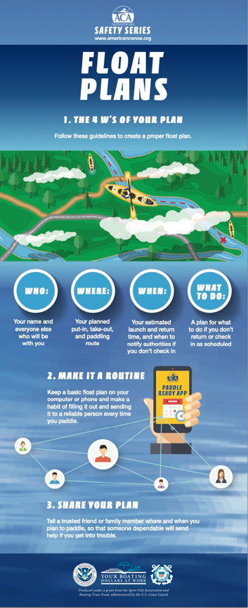
Float Plan
Share the plan with a trusted friend:
Who
Where
When
What
Notes:
Float Plan
Once you are all set, develop an appropriate float plan for your trip. File it close to your departure time.
WHO is paddling? Name, number of craft, demographic/risk info if applicable. Your contact info.
WHERE are you paddling? Be as specific as possible regarding the intended direction and distance, as appropriate.
WHEN is your intended start are return time?
WHAT should be done if you are overdue?
Good idea: Take a selfie at the put-in and send it with the float plan to a person not on the trip
This simple float plan guide is taken from the ACA—it is designed more for paddlers than the float plan on the Coast Guard app.
Share the plan with a trusted friend:
Who: your name and anyone else with you.
Where: your put-in, take-out, and paddling route.
When: your estimated launch and return time, and when to notify authorities if you don’t check-in.
What: a plan for what to do if you don’t check in.
The instructor needs to emphasize that the float plan is given to someone who should be able to call authorities if you are missing and would know when to make that call using the info on the plan. It does not have to be a formal document. The ACA app is available for either iOS or Android and is free in the app stores. The ACA app can be updated while underway and sent to the plan recipient.
Make sure the person receiving the float plan knows that if they have not heard from the paddler by X time they should take Y action.

Slide 46
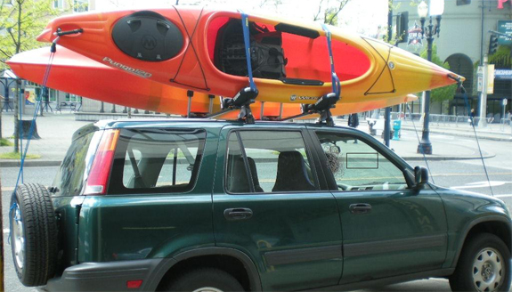
Getting to the Water
Fasten vessel securely
Shock cord is not adequate
Straps are preferable, plus bow and stern lines
Get help with loading & carrying your boat
Notes:
Transporting and securing your boat:
Drivers are responsible for the load on, or towed by, their vehicle! If it comes off and damages someone or something, you are liable.
Use appropriate knots, ropes, and straps to secure your boat
Tie at two points across the beam to secure to the rack, tie bow and stern to secure to a vehicle (four-point tie down is best)
Ensure nothing can blow out during transport
Use appropriate racks or trailers for your boat
Consider using locks to secure your boat
Shock cord or other stretchy material is not adequate—use stout line (rope) or locking straps

Slide 47
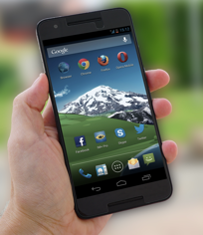
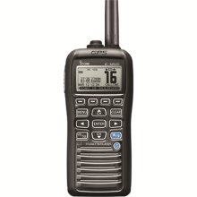
At the Water’s Edge
Review the plan with the team
Go/no go decision
Equipment re-check (checklist)
File your float plan
Clarify your group communications
Notes:
At the water’s edge
Personal/Team Check-In
Weather and water conditions (wind, weather events, tides, currents, etc.)
Route knowledge and knowledge of hazards and markers (shallow water, busy channels, dams, no boating areas, etc.)
Limits and concerns (health needs, injuries, anxiety, etc.)
Skills and knowledge
Equipment Recheck
Make sure everyone has appropriate safety and protective equipment, including a life jacket that is being worn and used appropriately.
Make sure that everyone’s boat, paddle, life jacket, and additional equipment are in good working order before setting out—look for cracks, holes, tears, and other damage.
Appropriately secure all equipment in the boat, both so the boat is balanced correctly and to ensure equipment is not lost during a capsize. Are hatches secure?
Group Communication
Review and agree to the proper use of hand signals, sounds, and other communication protocols. Signals used on rivers may be different than those used in coastal areas. Be sure to learn signals used where you’re paddling. Open water signals can be found in the most recent version of the NAVRULES (https://www.navcen.uscg.gov/sites/default/files/pdf/navRules/navrules.pdf) . River signals used by recreational paddlers are found at https://www.americanwhitewater.org/content/Wiki/safety:start.
Float Plan
File using a float plan app, call it into someone you know, leave a written document in your vehicle
*Review the plan with the team
Go/no go decision

Slide 48
2. On the Water!

Slide 49
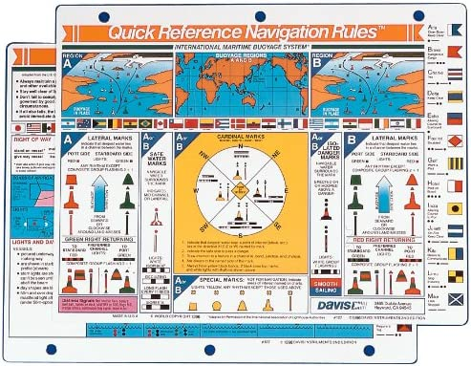
On the Water
Boarding and exiting
Rules of the road
Communication
Awareness
Emergencies

Slide 50



On the Water
Boarding/exiting
Fun with a group
Notes:
On the water
Boarding, exiting, and moving about the boat
Don your life jacket before boarding, and keep it on all the time during the paddling trip
When boarding or exiting a boat, keep weight low and move slowly to reduce the risk of capsize
Maintain at least three points of contact when boarding, exiting, or moving about the boat
Avoid switching positions once away from shore. If you do move, use good principles (such as moving one person at a time, moving slowly, moving along the center line, and maintaining a low center of gravity).
Avoid sudden movements in the boat
Paddling
Paddling in groups of three or more is generally safer
Do not use drugs or alcohol either before or while on the water
Boat politely – look out for yourself and everyone else on the water
Boat conservatively – stay within your skill level
Hands-on instruction makes paddling safer and more fun
Other activities
Anglers and hunters should be extra vigilant about weight shifts, appropriate equipment, and life jacket use
Animals should use properly fitted life jackets
Anticipate sudden movements from animals in boats
Remember boat ramp etiquette. Check your gear in the parking area and drop your boat off quickly. Place your boat at the side of the ramp, so it doesn't block access. Remember that power boats can only use a boat ramp to access the water. If possible, paddlers should look for other access points.

Slide 51

Rules of the Road
Nav Rules do not state that paddlecraft have “right of way”
Observe channel markers and note boat traffic—stay clear
Respect “Rule of Gross Tonnage”
Notes:
Travel on our waterways is governed by both federal and state law. Just like our system of streets and highways, we have a system of waterways. As a paddler, you should know the waterways and rules well.
Channels. Channels are areas of safe passage and often high traffic. They are typically marked by red and green aids for navigation.
As a paddler, you should be able to identify channels and avoid paddling in or across them whenever possible.
When crossing channels as a group, ensure there’s no conflicting traffic.
Markers signal special hazards and warnings. As a paddler, you should be especially familiar with markers denoting danger and/or restricted entry.
Avoid navigable channels and stay as close as feasible to shore; when crossing channels, spend as little time as possible in them.
Even when you are convinced you are the “stand-on” vessel, it is wise to defer to larger vessels.
Be deliberate in navigating around other vessels so that other operators can clearly observe your intentions.
Keep out of the main channel. If you must be in a channel, stay close to the right side. If you have to cross a channel, travel in a group, at a narrow point in the channel, after checking for traffic.
Paddlecraft can often navigate closer inshore than power vessels and stay outside lateral navigation markers.
On rivers with less powerboat/commercial barge boat traffic, the craft moving downstream has right of way. On rivers with powerboats and barge traffic, stay out of the way of the bigger boats.

Slide 52



Communication
Know Basic Hand Signals
Discuss in Advance
Carry a Whistle
Radio and/or Phone
Distress Signals
Notes:
Communication is essential and may be life-saving.
Always discuss communication in advance with those you paddle with.
Know the basic hand signals (INSTRUCTOR NOTE: Demonstrate)
Carry a whistle, easily accessed from your PFD. Consider also an air horn
Carry a fully charged phone in a waterproof case. Consider a VHF marine radio.
Know common distress signals (INSTRUCTOR: demonstrate plus handout)
Under the Navigation Rules, five or more short blasts is used to indicate a danger, that a vessel operator is unsure of another vessel’s intent, or that they disagree with another vessel’s intent. Paddlers should know this, particularly if operating around motorized vessels.
However, paddlers often operate in remote area well away from other types of craft. As a result, paddlers traditionally have used the emergency signal used in the wilderness - three whistle blasts. This was codified by American Whitewater’s Safety Code (https://www.americanwhitewater.org/content/Wiki/safety:start) in 1959 and has been used by paddlers for more than seven decades.
Three whistle blasts as an emergency signal have been widely referenced by many groups including the American Canoe Association (the National Governing Body for Olympic and Paralympic paddlesports), Scouting USA, and the National Association of State Boating Law Administrators. All boaters should be aware of both emergency signals.

Slide 53


Situational Awareness
Changes in
weather
Others in
your group
Other vessels
Notes:
*Situational awareness is necessary for safety.
This means keeping an eye on weather and sea conditions, being alert to other vessels, and looking out for others in your group. All of these can be rapidly changing. (INSTRUCTOR: Provide some relevant and local examples)
*Human-powered craft are especially vulnerable because they are hard to spot and can be run over by recreational and commercial power vessels.
*The Navigation Rules provide a structured way to learn the relationship between various types of boats and ships.
*If paddling on navigable waters, be especially aware of other boats and of your, the paddler’s, responsibilities to keep clear.

Slide 54


Situational Awareness:
Closing Distance
¼ Mile
Response times:
@60 mph—15 seconds
@45 mph—20 seconds
@30 mph—30 seconds
Notes:
At one-quarter of a mile—the distance a boater is apt first to see a paddler, the reaction time is proportional to speed. INCREASE YOUR VISIBILITY TO REDUCE YOUR RISK.
Be aware of boat traffic and stay to the right side or away from the main channel as much as possible.

Slide 55

Emergencies/Prevention
Weather-related
Human-induced: alcohol/drugs
Accidents or illness
Practice yourself and assisted rescues
TAKE ACA CLASSES!
Notes:
Emergencies
PREVENTION Avoid problems. The best rescue is the one that is prevented
Check water and weather conditions, and be flexible when what you expect doesn’t match what you find
If bad weather or water conditions are forecast, wait for better conditions
Use knowledge, skills, abilities, and equipment to avoid problems, and reduce the impact of problems when they happen
Alcohol and illicit drugs have no place in paddling. Consider the effect of medications – some medications may affect your judgment or make you drowsy, and others may increase your sensitivity to sunburn or dehydration
Capsizing and falls overboard are part of paddling – learn how to manage them when they happen
INSTRUCTOR NOTE: Reinforce the availability of ACA skills courses. Know the local ones in your area.

Slide 56
3. After Your Trip

Slide 57

After Your Trip
Notify those who have
your float plan
Debrief
  Had fun?
  What went
  well?
  Lessons learned?
Clean and protect your equipment
Keep learning!
Notes:
After your trip
Let friends who have your float plan know you are back safely!
Debrief…what went well, what did not, and what did we learn?
Take care of your gear.
After your trip, clean and store your equipment appropriately. Avoid phosphate-containing soaps and avoid transporting aquatic plants and animals
Check your gear to make sure it is still in good working condition
Repair any damaged gear before you need to use it again
Keep learning and paddling.ng
Local clubs and schools, and local paddling shops, are a great resource for paddling information and for paddling partners
Regional and national programs can help you find a local instructor
ACA’s website provides lists of instructors and clubs, and lists of water trails
Paddlesports are a lifelong activity

Slide 58
REVIEW/QUESTIONS SECTION II
1. What steps can improve your pre-trip planning?
2. What is a float plan? What is in it, and how do you “file” it?
3. What is hypothermia? How does it happen? How do you prevent it?
Notes:
What steps can improve your pre-trip planning?
What is a float plan? What goes in it, and how do you “file” it?
What is hypothermia? How does it happen? How do you prevent it?

Slide 59
REVIEW/QUESTIONS SECTION II
4. What are some common hand signals used by paddlers?
5. What do five blasts on the horn or whistle mean?
6. What are some common distress signals used by paddlers?
7. How do you use a marine radio to get help?
Notes:
What are some common hand signals used by paddlers?
What does five blasts on a horn mean?
What are some common distress signals used by paddlers?
How do you use a marine radio to get help?

Slide 60
REVIEW/QUESTIONS SECTION II
8. What is situational awareness? What are some examples relevant to your paddling experience?
9. Name common paddling emergencies and how to prevent and prepare for them.
Notes:
What is situational awareness? What are some examples relevant to your paddling experience?
Name common paddling emergencies and how to prevent and prepare for them.

Slide 61
III. SUP and FISHING KAYAKS
Notes:
INSTRUCTOR NOTE: This section is used when/if there is a relevant audience present.
SUPs need mention of a leash
Canoes need mention of moving about in them.
Fishing kayaks are still kayaks - there’s just more gear. However, some people pile gear on their deck creating the same hazards as anglers face. Fishing is done from kayaks, canoes and SUPs

Slide 62
Many Practices Apply to all Paddlecraft
Wear a life jacket -- attach a whistle
Understand the rules of the road
  Navigation Rules
  Local Regulations
  Five (5) toots of the whistle or horn to signal danger/doubt
Know the weather – current and forecast
Notes:
Safety Guidelines that apply to all paddlecraft:
Always wear a life jacket with an attached whistle
Always wear vs. carry onboard
Rules of the road - Navigation Rules –
Rule 2 – A boater is responsible to avoid a collision, and nothing in the rules absolves the boater from that responsibility. Even if you follow the rules and a collision occurs, you could be held responsible. In other words, if avoiding a collision involves breaking the rules, you must do everything possible to avoid the collision.
There is a hierarchy in the Rules of the Road that determines which boat must stay out of the way of the other, based on maneuverability. The commonly used mnemonic for remembering this is: Only New Reels Catch Fish So Purchase Some.
Basically, a boat that is being overtaken always is the stand-on vessel (Only)
The next category of stand-only vessel is one that is not under commander – i.e., having steering or mechanical issues (New).
After that, vessels restricted in their ability to maneuver – i.e., a dredge or ATON boat (Reels)
Then vessels constrained by draft – i.e., must stay in the channel because of draft (Catch)
Fishing vessels come next – with their nets or lines extended (Fish)
Sailing vessels have to give way to all the prior ones (So)
Powerboats are pretty much the most maneuverable (Purchase) and must give way, except for Seaplanes (Some).
Local regulations –
Do not enter
Distress Signals – continuous blowing of the whistle. In general, multiple whistle blasts repeated indicate distress, doubt, or an emergency. Three blasts is the general outdoor emergency signal and more likely to be used in inland environments.
Weather – Wind, rain, summer thunderstorms, potential takeout locations, etc.?

Slide 63

Many Practices Apply to all Paddlecraft
What to Wear - Dress for immersion
Take a class – Learn how to:
  Rescue yourself
  Rescue someone else
Notes:
Safety Guidelines that apply to all paddlecraft:
Take a paddlecraft safety course – See more at https://wow.uscgaux.info/content.php?unit=113-06-04&category=paddle-boarding
Learn how to rescue yourself
Learn how to rescue someone else
Learn how to paddle efficiently
Take a powerboat course – Learn what the other guy should be doing!
Should be self-evident:
Learn to swim, be a competent swimmer, etc.

Slide 64

Considerations for SUPs:
Stand Up Paddleboards
Many prefer an inflatable belt PFD—wear it
Ankle leash for flat
water – stay with your vessel
Proper footwear
Right-size board
Notes:
SUPs
Stand Up Paddleboards-SUPs-are legally defined as vessels. Operators must have a life jacket aboard EXCEPT in a surf zone. Inflatable belts are commonly used.
The paddler has the right size board, is properly wearing an inflatable life jacket, has on suitable footwear, and has a leash that attaches her to the board by way of her right ankle.
Ankle leashes are useful, but not for surf, swift currents, or conditions where being tied to the board could prove dangerous—situational decision-making applies.
Learn what types of leashes and lifejackets are appropriate for different water venues.
Leashes are always appropriate on calm water. In moving water, there’s debate. In ocean surf, they may be required.
Depending on the area, expand the SUP section and reference additional material.

Slide 65

Considerations for
Kayak Fishing
What are the safety issues with kayak fishing?
Notes:
Always wear your life jacket!
Rescue order priority: 1st-the kayaker, 2nd-kayak, and lastly-equipment (You can always replace a $500 fishing pole, but we cannot replace you!)

Slide 66

Considerations for
Kayak Fishing
Landing the big one will challenge your balance
Anchor – from bow, not cockpit
All-around white
light if fishing at night
Lines in the water
  entanglement
  injury from hooks
Notes:
Always wear your life jacket!
There is always a possibility of a balance issue when reeling in the “big one.” Plus, paddlers may lose situational awareness and lean over the side to bring the fish aboard.
Lines in the water and fishing gear on deck:
Will make it difficult to re-enter the boat.
Hooks and lines in the water also should make swimming around the boat dangerous – entanglement and sharp objects are very big concerns!
Do you have a knife and a spare?
Anchoring:
Kayak anchoring requires some special equipment and knowledge to learn.
Anchor from the bow and not the cockpit – why?
Anchors used for kayak fishing often are mounted on traveler systems, allowing them to be moved from bow to stern. The slide shows gear fanned out above the paddler’s head - some anglers prefer to have the poles strapped to the deck and flat. This reduces entanglement risk but makes it harder to re-enter after capsize (you’d have to crawl over the pole).
Bio-break safely:
Take an empty bottle to relieve yourself. Mark it with duct tape so you don’t confuse it with your water bottle.
Situational Awareness
Are you paying attention to the weather?
Do you have a lookout for careless/inattentive powerboats?
Are you in the channel, away from commercial vessels (tugboats, cargo ships, etc.)

Slide 67
Considerations for
Kayak Fishing
Lots of loose gear– what happens with a capsize?
Wide and heavy kayak-- can you right it?
Can you re-enter alone? With help?
Are waders a good idea?
Do you need a life jacket?
Notes:
Waders, hunting jackets, sandals, and other inappropriate gear can be a hazard in the water—particularly in cold water.
Many who fish from kayaks do not think of themselves as boaters.

Slide 68

Canoe Safety
Notes:
OPTIONAL Content
Golden Rules of Canoeing | How to Stay Safe on the Water. This is a link to a four-minute canoe safety video sponsored by the Coast Guard and ACA.
https://www.youtube.com/watch?v=a6Qy5sVRCtk
ALTERNATIVELY, SEEK ASSISTANCE FROM ACA FOR A SLIDE OR TWO ON CANOE SAFETY

Slide 69
REVIEW/QUESTIONS SECTION III
What are some of the most important gear that applies to all paddlecraft?
What is a leash for on a stand-up paddleboard?
What are some safety issues related to kayak fishing?
If you are going to anchor your kayak, where do you attach it to the kayak?
What is situational awareness, and why is it important to your safety?
Notes:
1. What are some of the most important gear that applies to all paddlecraft?
2. What is a leash for on a stand-up paddleboard?
3. What are some safety issues related to kayak fishing?
4. If you are going to anchor your kayak, where do you attach it to the kayak?
5. What is situational awareness, and why is it important to your safety?

Slide 70
IV. RESOURCES
Notes:
INSTRUCTOR NOTE: At the conclusion of this section, students should be able to locate and use a variety of qualified paddling resources available through the CGAUX and ACA and identify ways to connect with other paddlers.

Slide 71
Resources
Phone Apps
Training/Education (ACA and CGAUX)
Finding other paddlers
Get a vessel safety check
Notes:
INSTRUCTOR NOTE: Have the URLS, app store, web, and other references for these resources LOCALLY on hand for sharing with the audience.
“Here are four resource categories that we should cover.”

Slide 72


Boating Accidents
Report Required
  Death or missing person
  Injury greater than first aid
  Damage greater than $2,000
Notes:
After the problem
* Accident reports are required anytime a fatality occurs, a person has to go to the hospital, the boat is lost, or significant property damage occurs
* Check with your state boat law administrator for state-specific rules
Accident reports should be made to the local state boating law enforcement agency.
The form is on the ACA App or at https://uscgboating.org/images/725.PDF

Slide 73

Mobile Phone Apps
Wind and weather
  NOAA Marine Weather Forecast
  Windy -- wind is critical on open water
  Weatherbug – with
  lightning tracker
Maps, charts, and launches
  Google Maps – for maps
  Aqua Map – for charting
  Go Paddle app and paddling.com – launch sites
Notes:
These are just some of the mobile phone apps that can be useful in assessing the wind and weather– and in charting the course.
Paddling.com and go paddle app provide useful information on local launches throughout the U.S.
Instructors should cite locally relevant resources.

Slide 74

Training and Education
https://americancanoe.org/
https://americancanoe.org for online and
in-person classes.
Notes:
We should elaborate on specific ACA and CGAUX training to share, and INSTRUCTORS will need to localize. ACA’s education page has a wealth of resources.
The Paddlesports Online course is free and provides a certificate for beginning paddlers.
The Paddlesports Safety Facilitator course is taught by some Auxiliarists who are also ACA Instructors. This is a one-day course with both shoreside and on-water components.
A rich variety of courses are offered in various disciplines, including
Recreational and SIt-on-Top Kayaking
Coastal Kayaking,
River/White Water Kayaking
SUP
Canoe
and many others. See https://americancanoe.org/
Paddle Responsibly Videos
The United States Coast Guard has partnered with Paddling.com to produce these short videos that illustrate proper gear, equipment, strokes, trip planning, recovering from a capsize, and how to call for help.

Slide 75
Get a Vessel Safety Check
How to request
  Identify local Vessel Examiners with expertise in paddlecraft
  Instructor to provide assistance
What to expect
  Check your vessel and gear
  Discuss trip planning and conditions in which you paddle
Notes:
NOTE: content needs refinement; local contacts for VSC are to be added by the instructor.
You can schedule a vessel safety check (VSC) not only for power and sailboats but also for kayaks and other paddlecraft. These examinations address legal requirements for your craft and equipment, as well as recommended equipment and practices. If your craft meets minimum requirements, a VSC Decal is issued indicating that you are in full compliance with federal and state boating laws. If deficiencies are found, they are noted in a written report for you, but no report is sent to federal or state agencies.
Most important, this is an excellent opportunity to discuss your questions about paddlecraft safety.

Slide 76
Paddlecraft Vessel Exam:
Requirements and Recommendations
III. Safety Check Requirements | Y | N | N/A | V. Other Recommendations | Y | N | N/A
Sound signal (whistle, horn, etc) |  |  |  | Dressed for immersion / helmet
Life jacket(s) |  |  |  | Personal ID on operator
Overall Vessel Condition: as applies |  |  |  | Float plan with someone on shore
a. Hull & deck sound |  |  |  | Adequate food and water / Sun Protection
b. Hatch covers (good condition/secure) |  |  |  | Assess the risk / good awareness
c. Deck lines & Bungee Cords |  |  |  | High visibility clothing, gear, etc.
d. Hardware secure (in working order) |  |  |  | Appropriate emergency kit (might include first-aid kit, knife, repair kit, etc.)
e. Bulkheads/Airbags/Flotation
f. Paddle / Oars (serviceable) |  |  |  | Appropriate self-rescue system / skills
Navigation Lights; White lights |  |  |  | Contact information affixed to craft
Visual Distress Signals (VDS) |  |  |  | Accident Reporting – Owner Responsible
State and/or Local Requirements |  |  |  | Anchor lights (if applicable)
IV. Open Water Recommendations |  |  |  | Vessel Examiner Comments
Pump or bailer
Spray skirt
Spare paddle / oars
Compass / GPS / navigation chart
Tow / boat recovery system
Marine radio (VHF) / cell phone / PLB

Slide 77


Identify your vessel
Paddle Reflectors
If Found Sticker
Notes:
Bring these to class to share with participants.

Slide 78

Have fun, but be safe!
Notes:
Risks are always at hand when you are on the water.
Our hope is that you learn about paddling so you can stay safe and have fun on the water.

Slide 79
REVIEW/QUESTIONS SECTION IV
1. What are some mobile apps useful to paddlers? Which are you most likely to use?
2. What are some good resources for continuing paddler education? Which might you use?
Notes:
What are some mobile apps useful to paddlers? Which are you most likely to use?
What are some good resources for continuing paddler education? Which might you use?

Slide 80
REVIEW/QUESTIONS SECTION IV
3. Why is it important to connect with other paddlers?
4. What resources might you use to do that?
5. What is a vessel safety check? How do you get one?
Notes:
Why is it important to connect with other paddlers?
What resources might you use to do that?
What is a vessel safety check? How do you get one?

Slide 81
V. OPEN FORUM
Notes:
INSTRUCTOR NOTE: This is your chance to give the group an additional opportunity to take responsibility for ensuring that they learned what they came to learn. Prime the dialogue with “we covered a lot of information so far… are there other topics you would like to talk more about or learn more about? Was the information clear? Anything that needs clarification, etc.?”
We have covered a lot of information, your participation has been great. At this point, I should be glad to answer any questions you have about paddling to the best of my ability.

Slide 82
THANK YOU
Presenter contact information here

Slide 83
REFERENCE ONLY BEYOND THIS POINT

Slide 84

LIFE JACKETS. Do not show this image—inflatables not good for paddling. Auto-inflate type is particularly problematic as paddlers get wet.
But might want to bring brochures to hand out with discussion of types of PFDs recommended..
PADDLECRAFT WEBSITE. May want to provide link to B Directorate national website which should be developed to include additional resources like checklists.
http://wow.uscgaux.info/content.php?unit=B-DEPT&category=for-paddlers
Notes:
During this demo, the instructor should show a typical paddling PFD. The instructor should point out the USCG label, show proper donning/adjusting for self and companion assist, show the use of pockets/pouch for storing emergency gear (with tethers?) and reinforce that unzipped/unworn is nearly useless.
You may want to bring the Right Life Jacket brochure to hand out.
You should discuss why some lifejackets are better for kayaking and other paddle sports.

Slide 85



Other Equipment
Notes:
Other equipment to consider bringing
Wear clothing designed for weather and water conditions—visible colors!
Bring adequate food, water, and extra clothing. Fill the bottle halfway so it floats and is easy to see —full may be more difficult to see due to neutral buoyancy
Use clothing and equipment (e.g., hats, sunblock, extra clothes) to reduce the risks of environmental problems such as hypothermia and sunburn
Match extra gear (e.g., helmets, radios, flotation bags, spare paddles, navigation tools) to the paddler, the group, the environment, and the desired activity
Carry appropriate rescue gear and learn how to use it
Navigation lights, distress signals and sounds signals may be required. Check with your local state boating officials to find out what you need to carry with you. Every paddler should have a whistle attached to their life jacket.
Printed pre-underway checklist
Pen or pencil + notebook/logbook
Sponge and/or manual pump for dewatering
Other gear needed for safe operation and self-rescue of the particular type of paddle craft: e.g., paddle float, paddle leash, spray skirt
Visual Distress Signals (VDS)
Bow line and/or stern line (“painter”) to tie up along a dock or ashore
Label or Nameplate affixed to the interior of the vessel, identifying Owner and "if found" phone numbers
In coastal waters, a waterproof VHF marine radio or portable VHF radio in clear plastic waterproof bag.
Watch, (waterproof)
Cell Phone in waterproof container as backup
Flashlight or Headlamp
Flotation foam or bags sufficient to permit self-rescue
GPS + Compass, hand-held or mounted
Rescue throw bag (smaller size for paddle craft, 30' max recommended)
Spare paddle/oar
First Aid Kit + emergency survival blankets (2) "space blankets"
Chart of Local Area
Repair equipment such as extra rudder cable, spare foot peg, drain plug
Additional rescue gear specific to your trip
Be sure to securely attach everything to your boat so nothing can float away after a capsize!

